Slide 1
Miniframe activity and status of the connections
Michel Morel
CERN-PH-ESE-FE
SPD meeting
INFN Bari, June 19th, 2009

Slide 2
Overview
- Miniframe 2008
- Scheme of patch panels
- Why did we modify the MF
- What’s new in MF 09
- MCM test

Slide 3
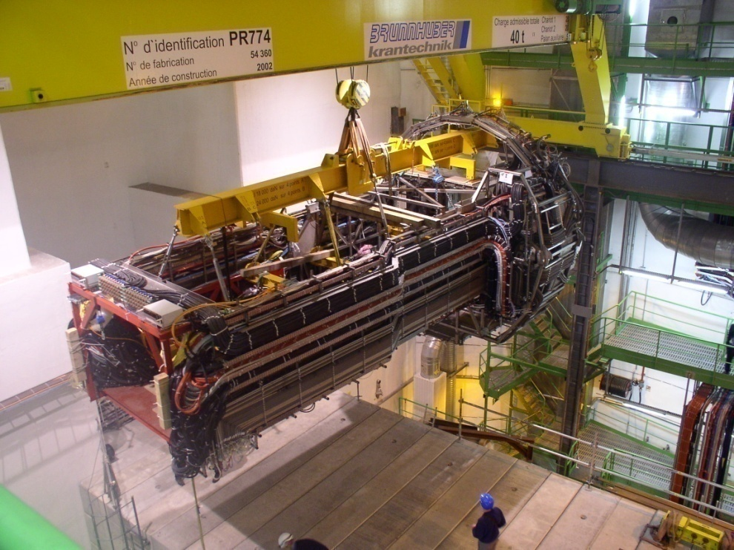
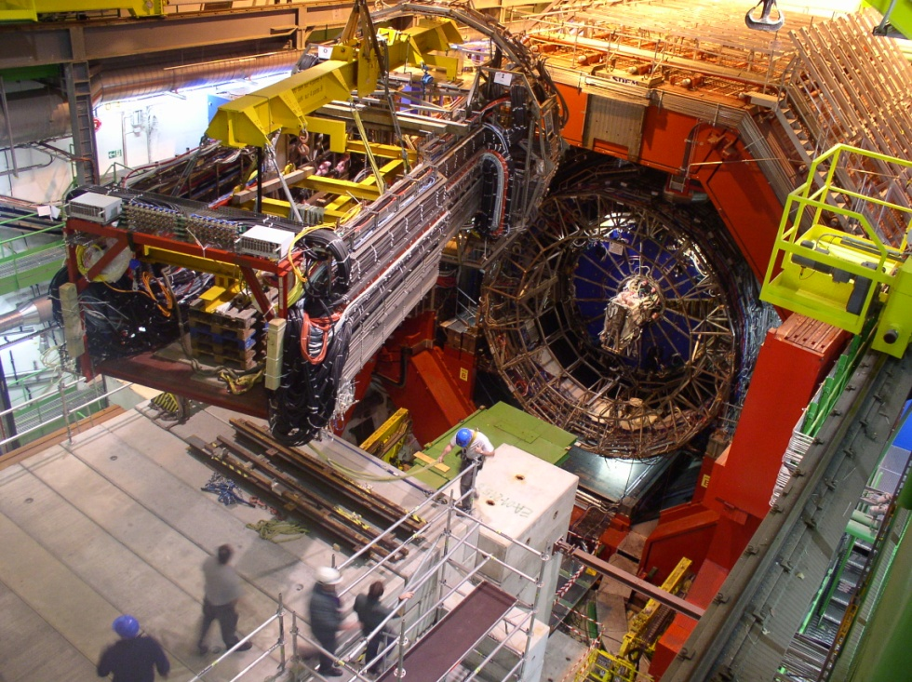
Miniframe 2008

Slide 4
Scheme of patch panel in side A

Slide 5
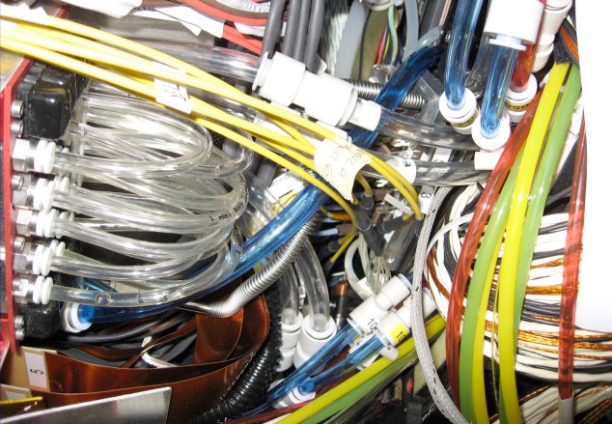
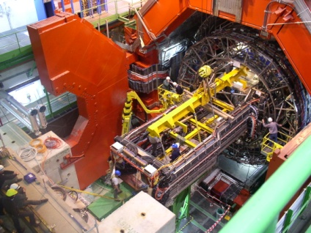
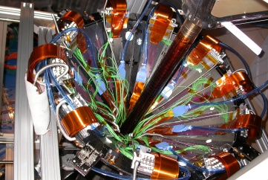
RB24-side A
Rack A13
PATCH PANEL A1
PIXEL
DETECTOR
PP0
Miniframe
PP1
PP2
Min =2m
Max=3m
Power
Supplies
1.5m
15m
21m
1.13m
CLK & SER
3.5m
Rack A14
PATCH PANEL A2
Optical
Patch panel
Power
Supplies
9m
Glink
To CR4
PP0T

Slide 6
Why did we modify the MF?

Slide 7
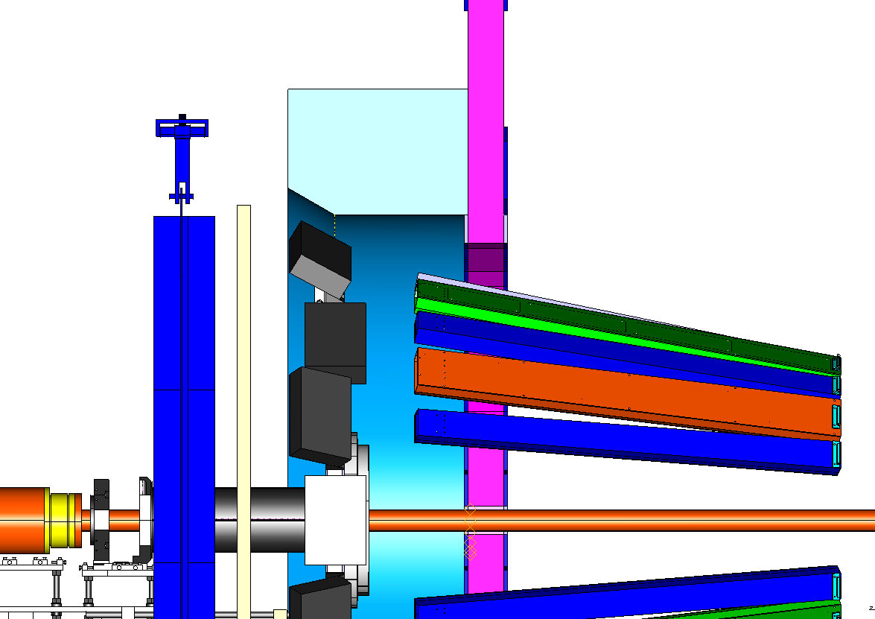
500 mm.
FREE AREA
370 mm.

Slide 8
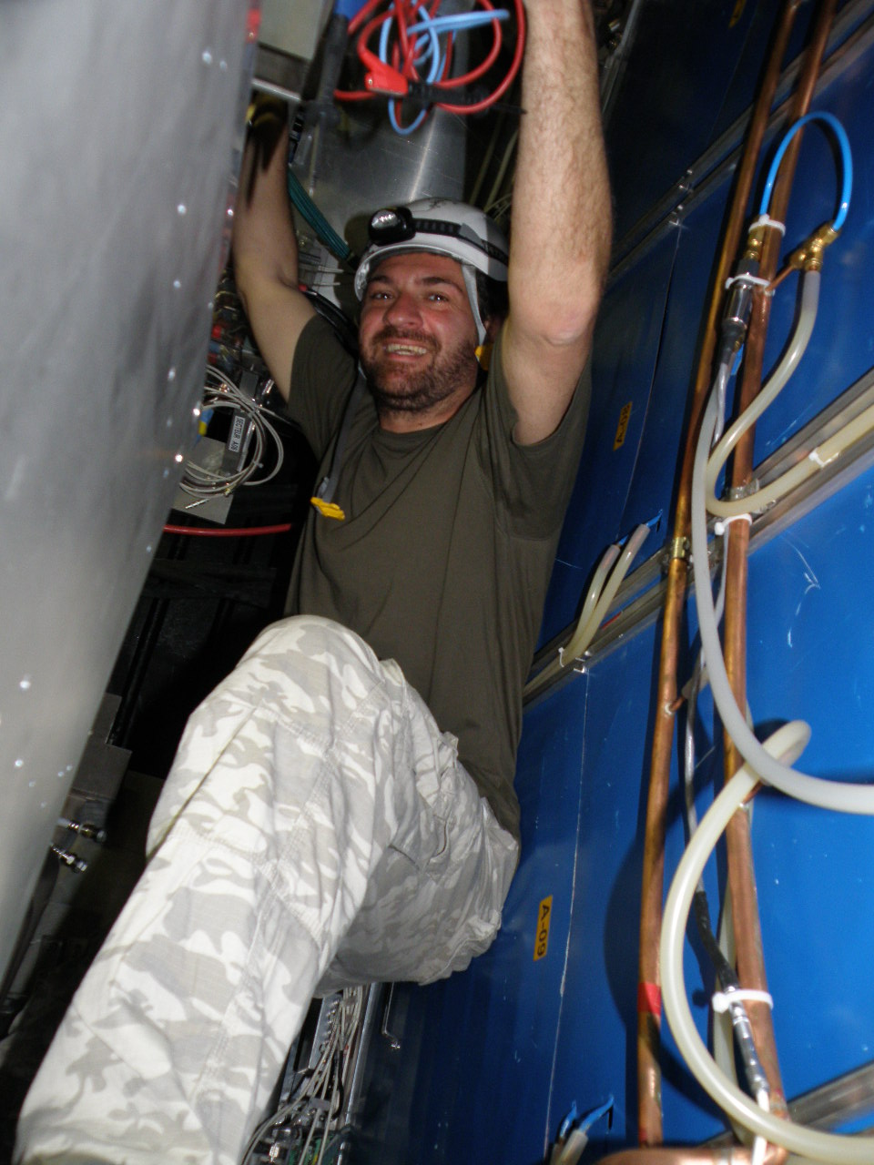
TPC team can now work in a very good conditions…

Slide 9
What’s new in the MF 09?

Slide 10
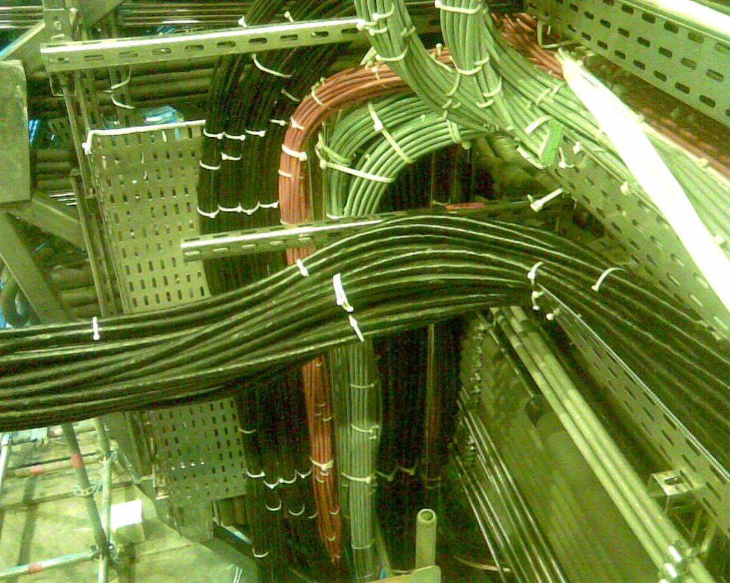
We have disconnected all
optical and electrical
connections at level of PP1
and reorganized supports and
routing of the cables.

Slide 11
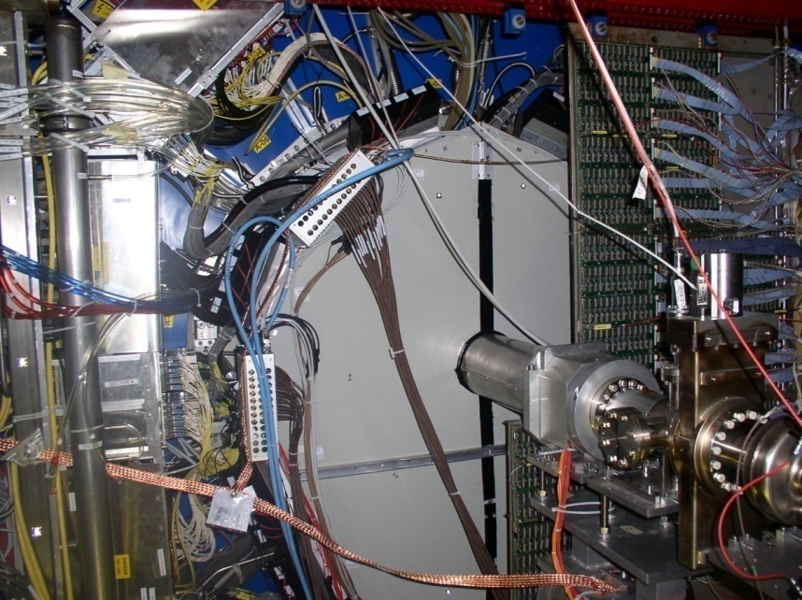
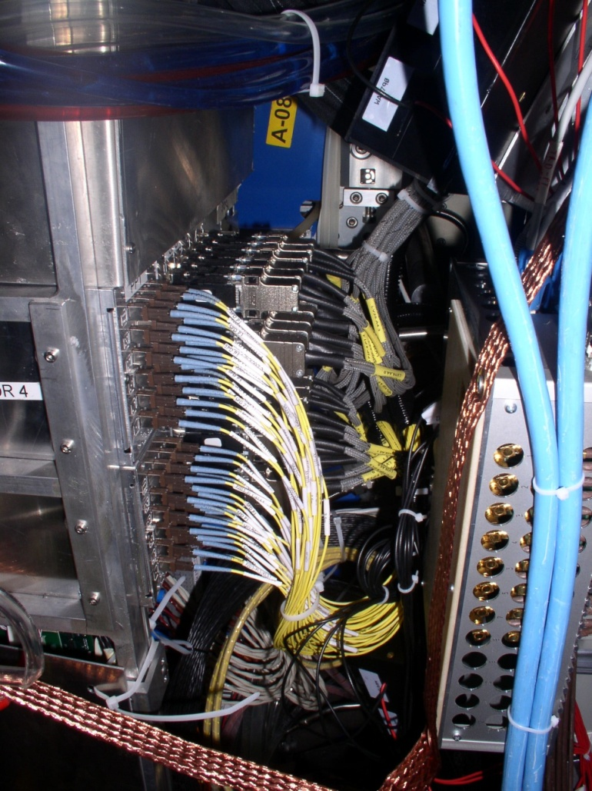
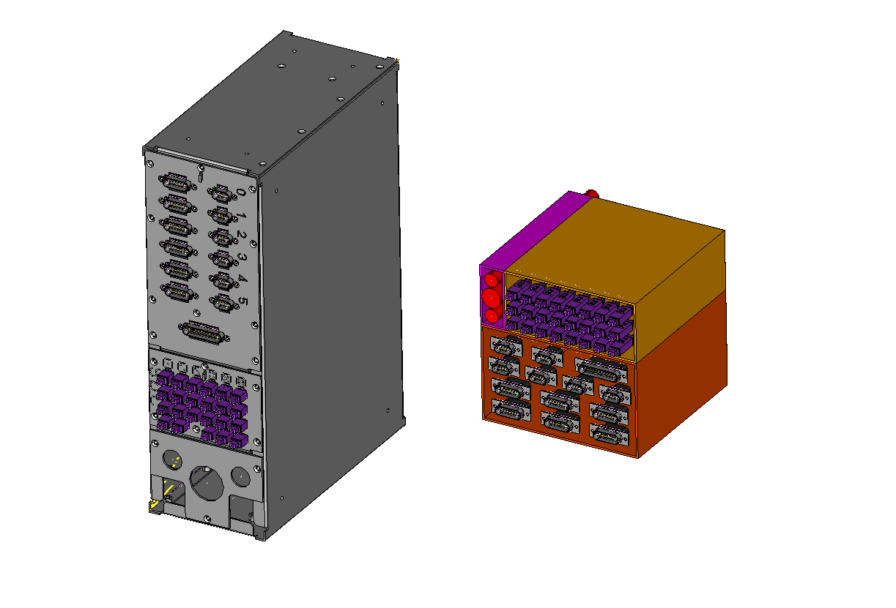
PP1 in 2008
Sector 4
New PP1(160x160x160)
Sector 5
Old PP1 (370x250x120)

Slide 12
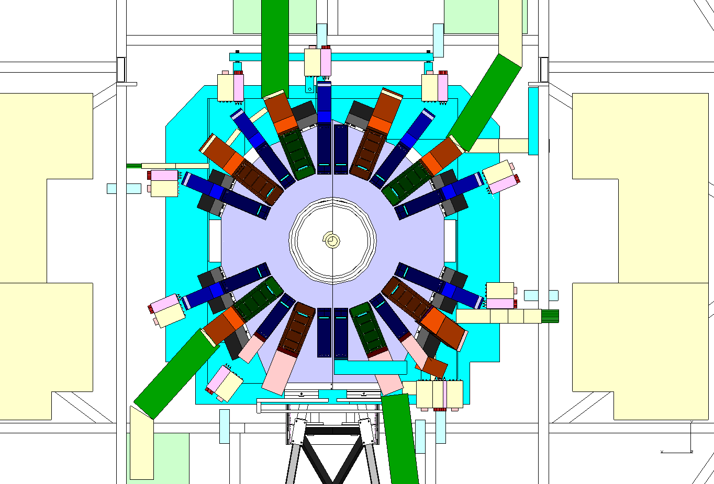
View: from IP to RB24
I Side
O Side
2
1
3
4
0
SPD new PP
SPD new PP
5
9
8
7
6

Slide 13
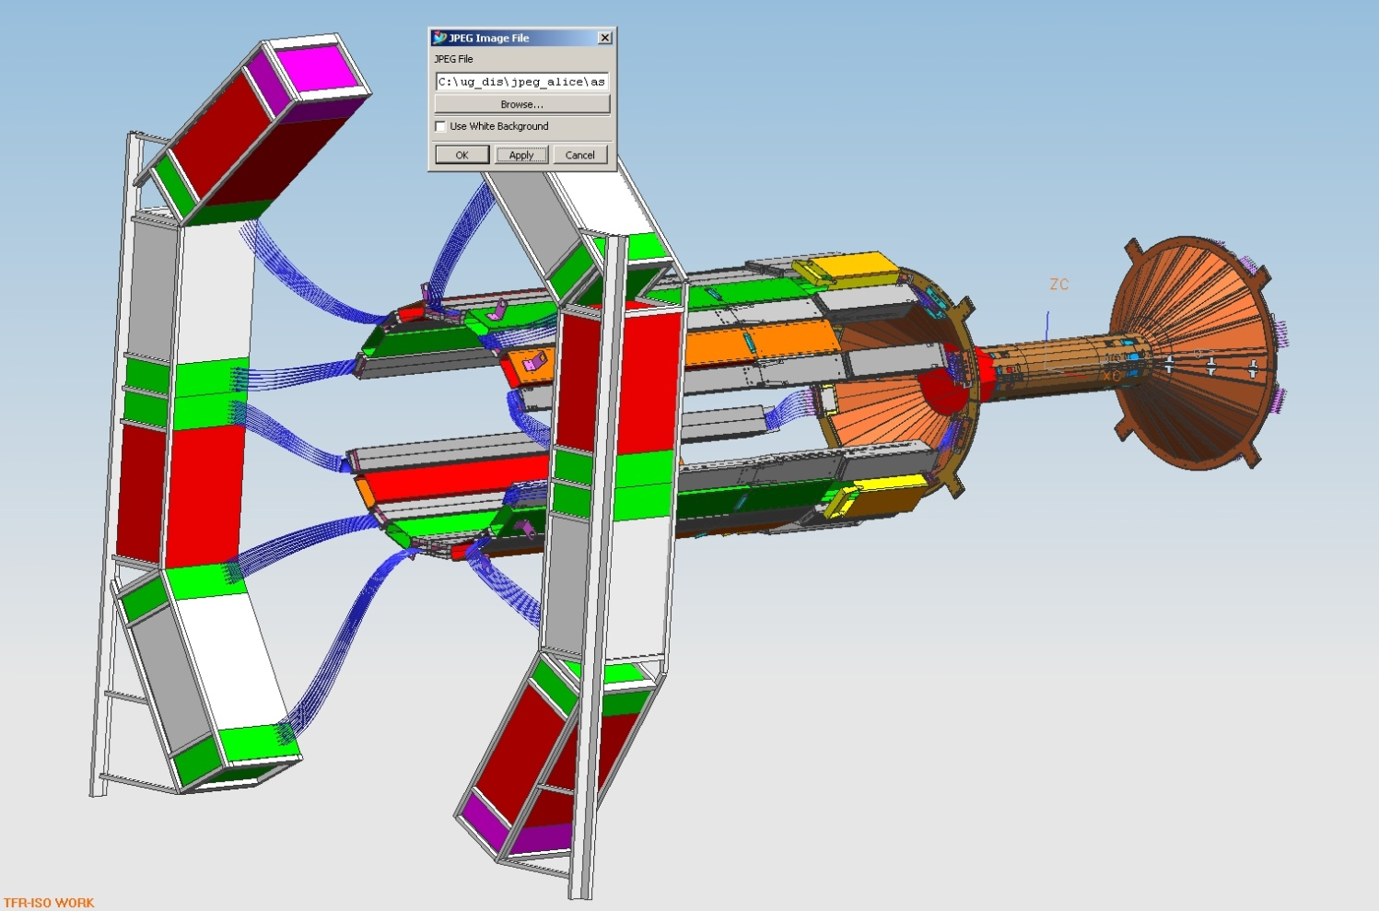
PP2
PP1
New organization of patch panels PP1

Slide 14
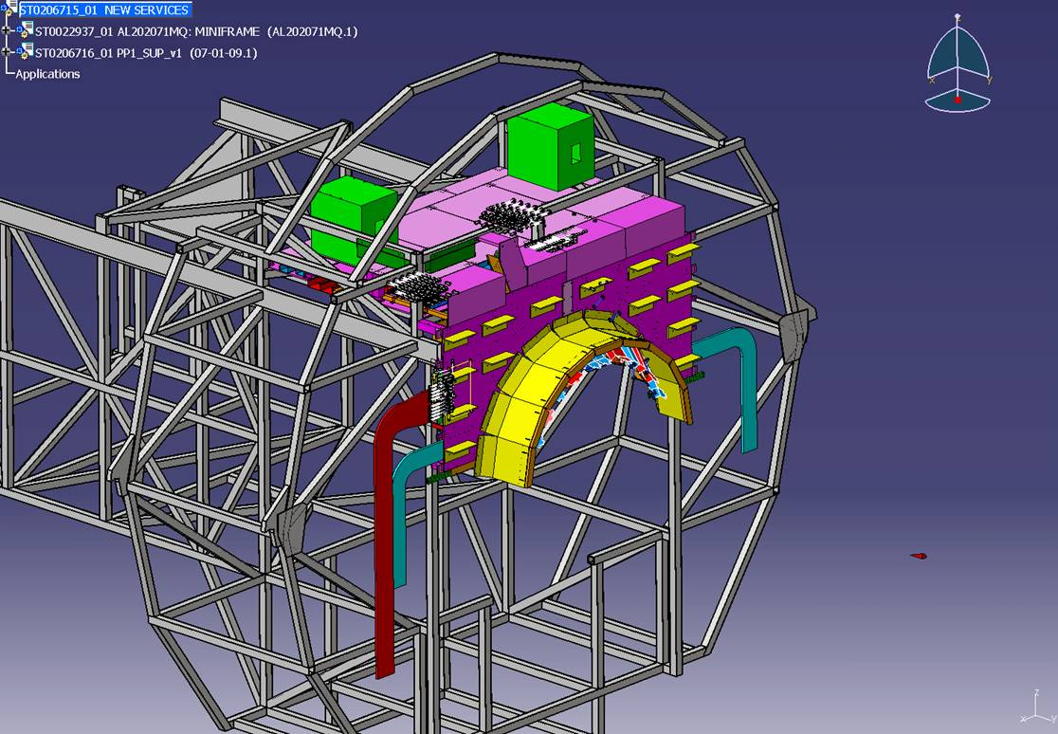

Slide 15
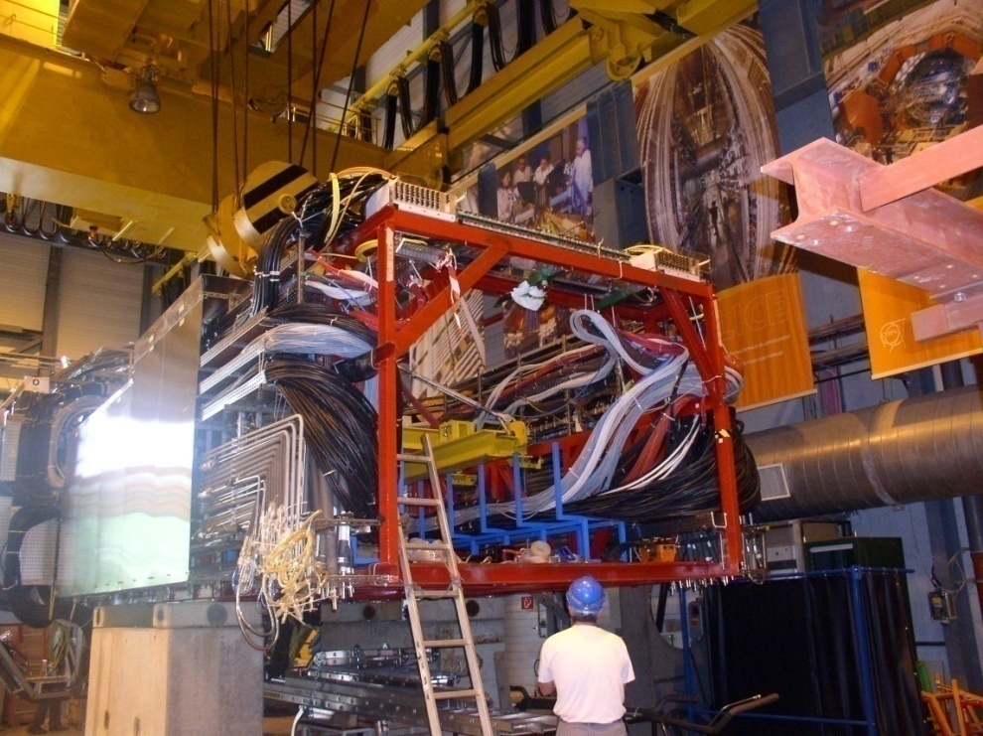
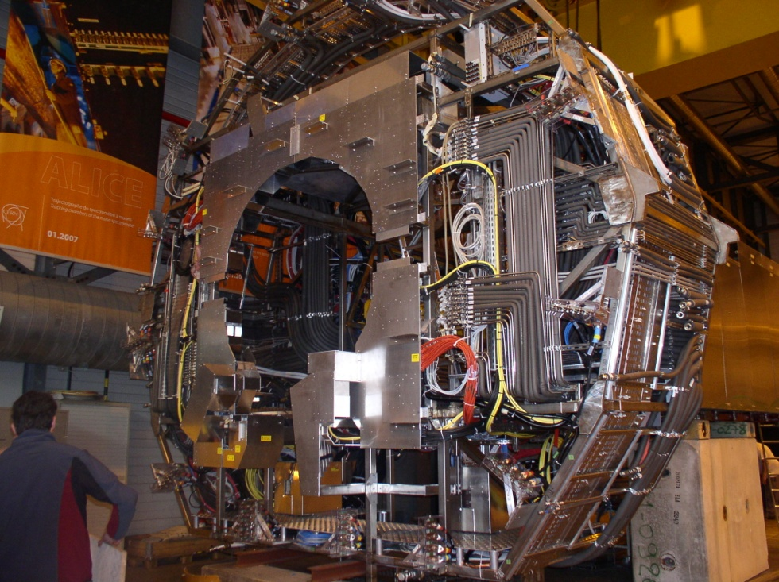
What’s new in the Miniframe 2009
MF was completed and
ready to move during week 20

Slide 16
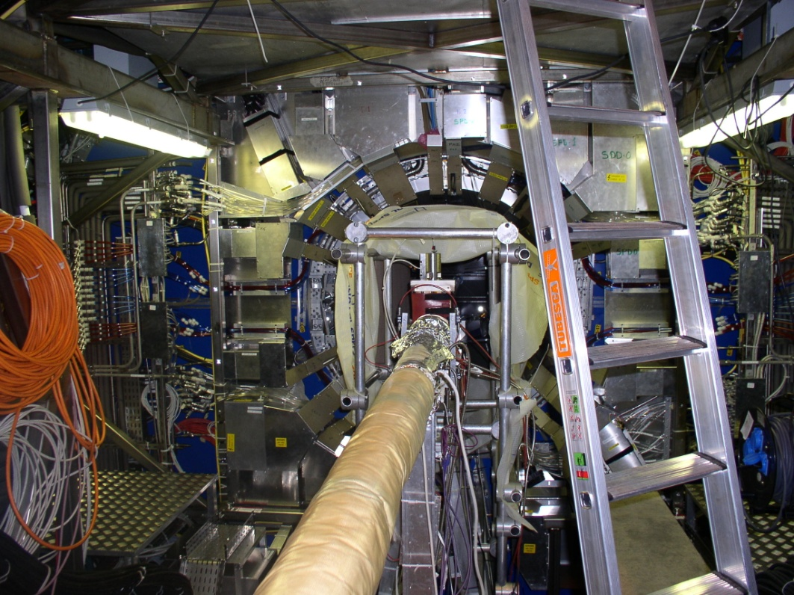
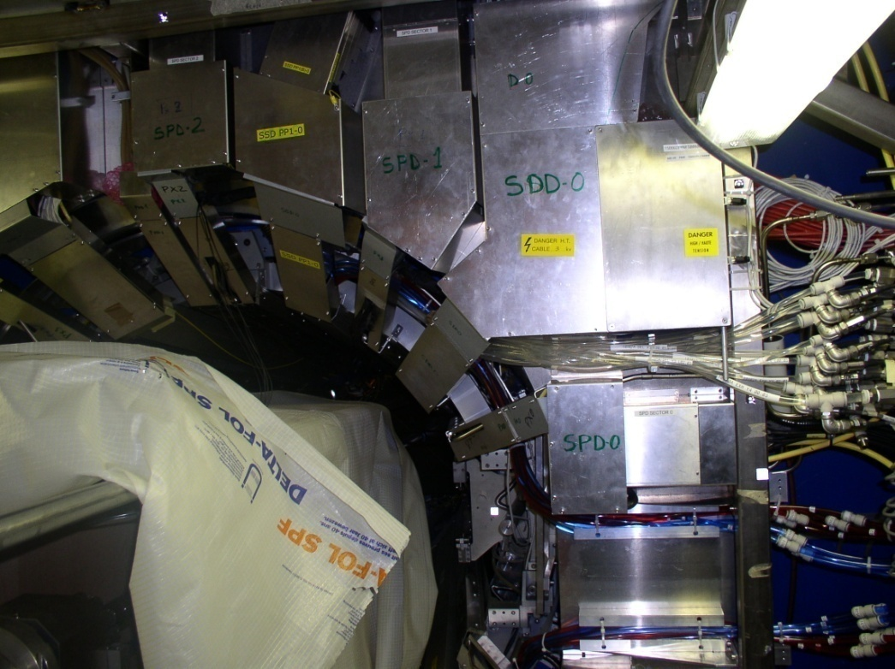
View from PP1 side

Slide 17
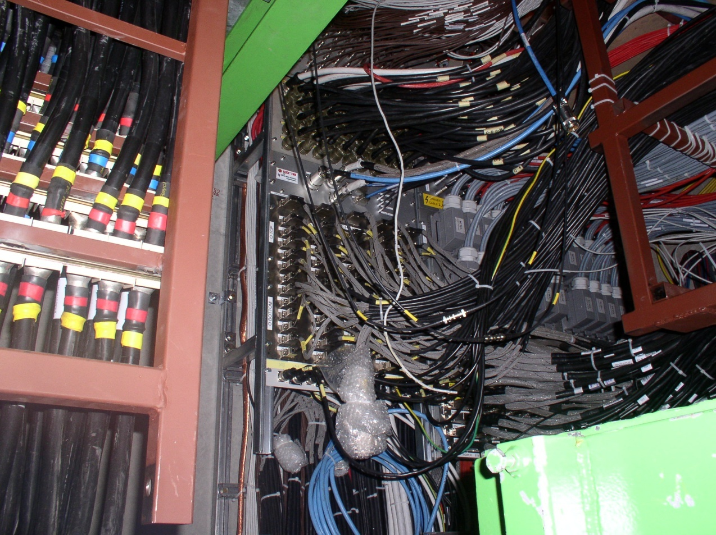
Rack A13
PATCH PANEL A1
PP0
Power
Supplies
1.5m
15m
Rack A14
PATCH PANEL A2
Power
Supplies
To CR4
No change at PP0

Slide 18
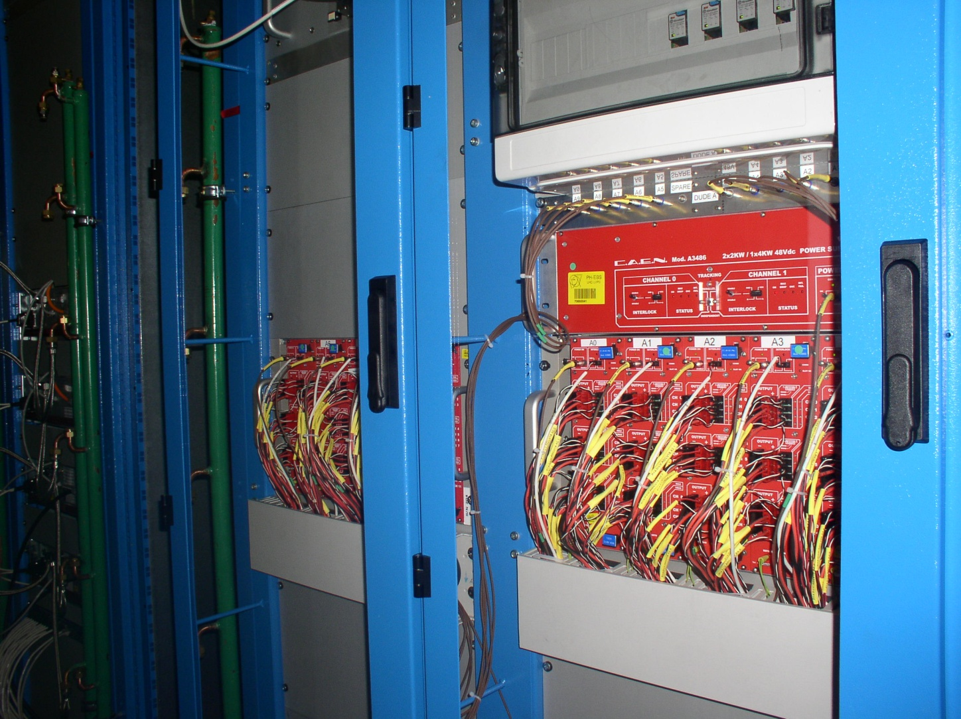
RB24-side A
Rack A13
PATCH PANEL A1
Power
Supplies
1.5m
15m
Rack A14
PATCH PANEL A2
Power
Supplies
Filters for CAEN 3486 modules have been installed
Doors protect all our crates A and C sides.

Slide 19
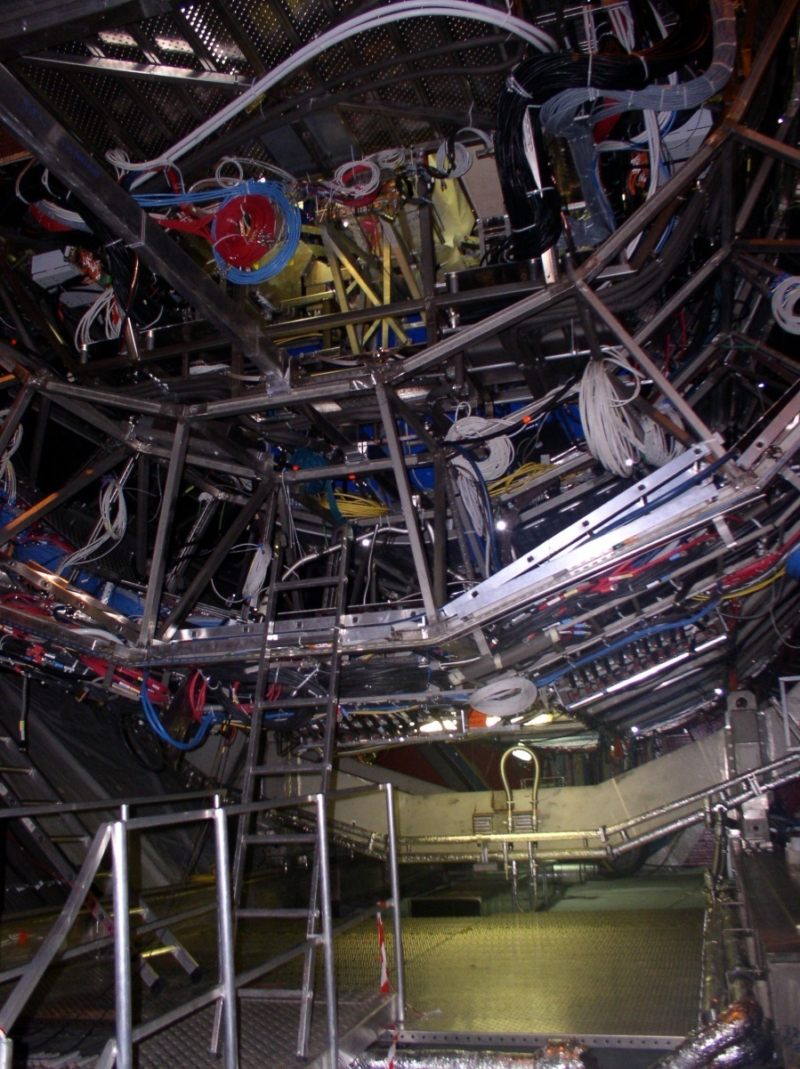
Optical patch panels PP0T
Rack A13
PATCH PANEL A1
PP0
PP1
Miniframe
Power
Supplies
1.5m
15m
21m
CLK & SER
Rack A14
PATCH PANEL A2
Power
Supplies
9m
Glink
To CR4
PP0T

Slide 20
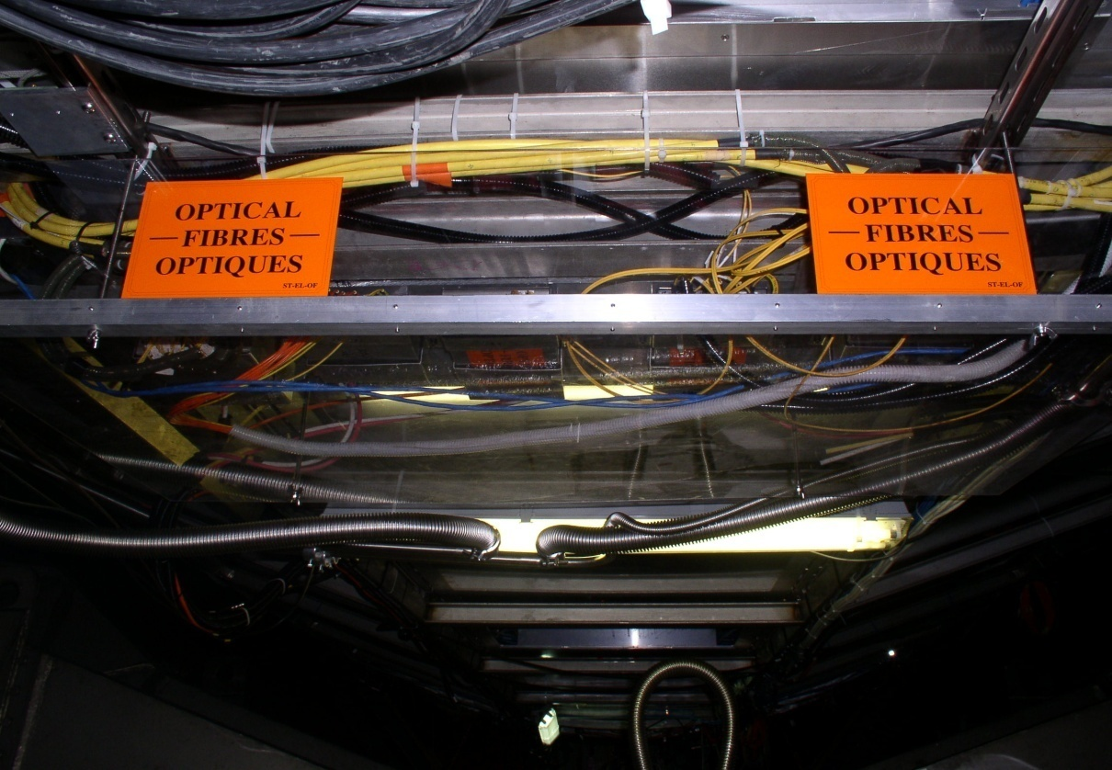
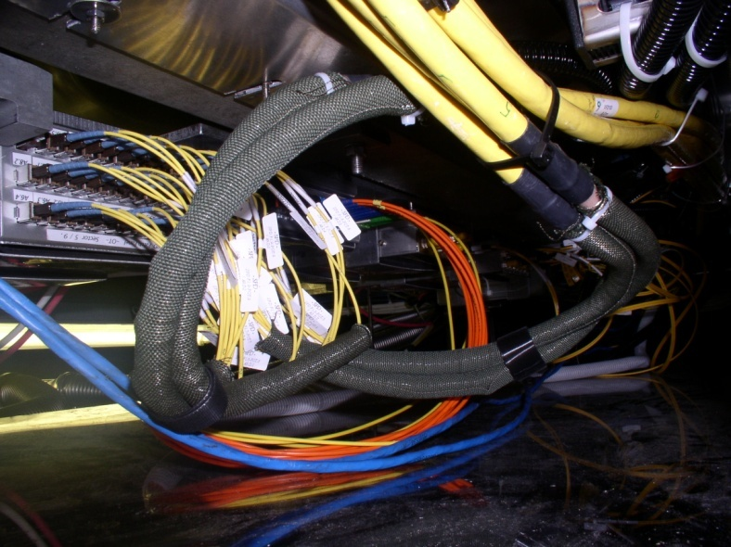
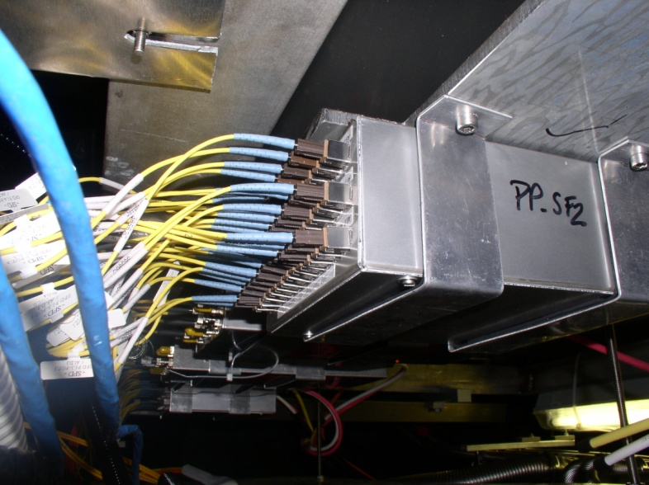
Optical patch panels PP0T

Slide 21
MCM power ON after 6 months…

Slide 22
1A0 Channel doesn’t work at Trigger level, CR4 OK:
This channel was swapped in PP0T
8A2 MCM Doesn’t lock:
we use the spare CLK fiber
3A3 MCM Doesn’t lock:
we use the spare data fiber
9C4 Channel doesn’t work at Trigger level, CR4 OK:
Channel 9C4 gave 33µW @ Trigger PP
70µW measured @ PP4
2C0 MCM has a very high resistance

Slide 23
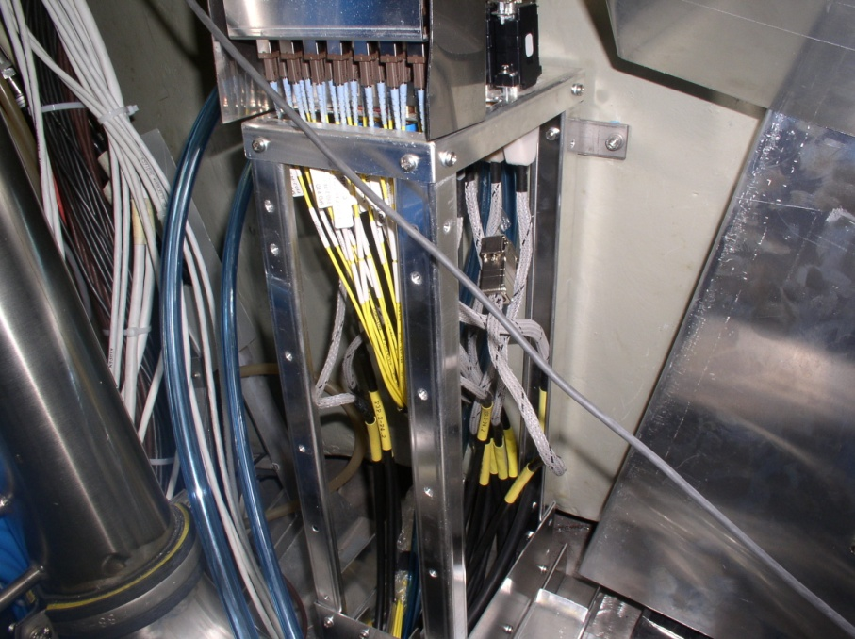
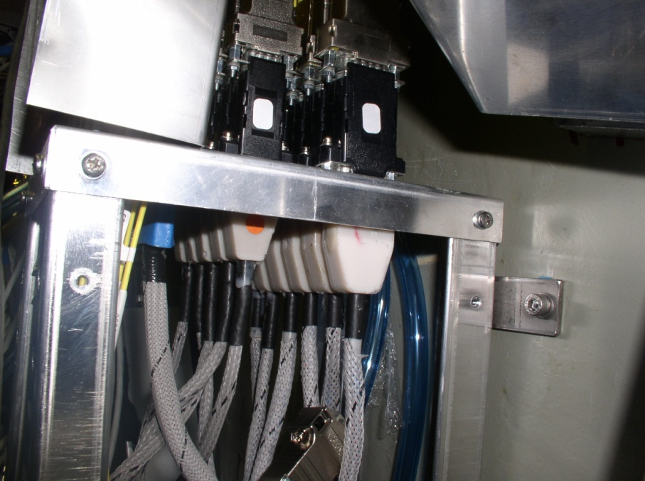
Faulty MCM channel 2C0
RB26-side C
PATCH PANEL 3
PATCH PANEL 4
PIXEL
DETECTOR
Normal MCM resistance: 250Ω
1.13m
4.5m
Resistance measured: 1K1

Slide 24
Conclusion
9C4 very low power (33µw). This channel could be recovered by increasing the laser current in the MCM.
We will Test this possibility in the pixel lab next week.
2C0 This MCM doesn’t work due to high resistance
Problem located in PP3 or in MCM itself.

