Slide 1
3rd meeting on GTK electro-mechanical integration

Slide 2
OUTLINE
Vessel dimensions
GTK assembly carrier
Electrical connections
Cooling pipes integration
Vessel alignment with the beam
Next steps
Conclusion

Slide 3
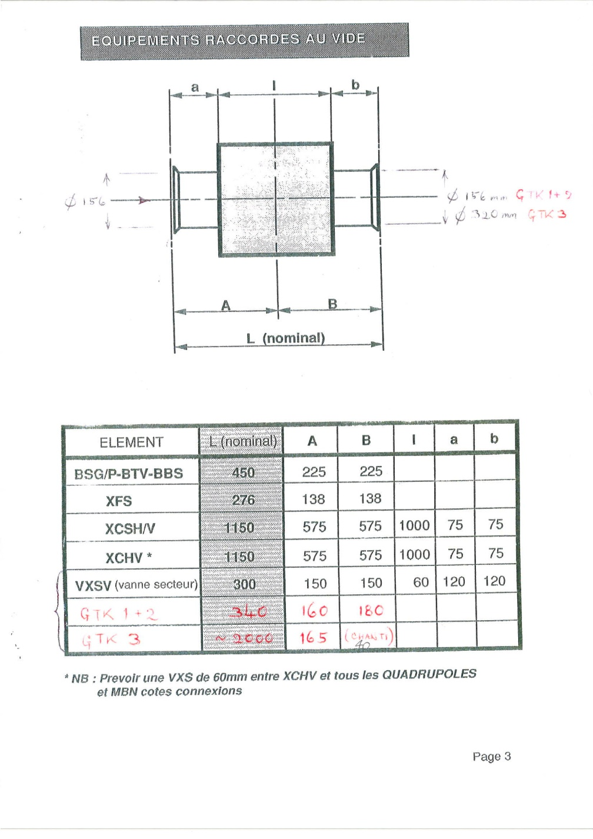
Vacuum Vessel

Slide 4
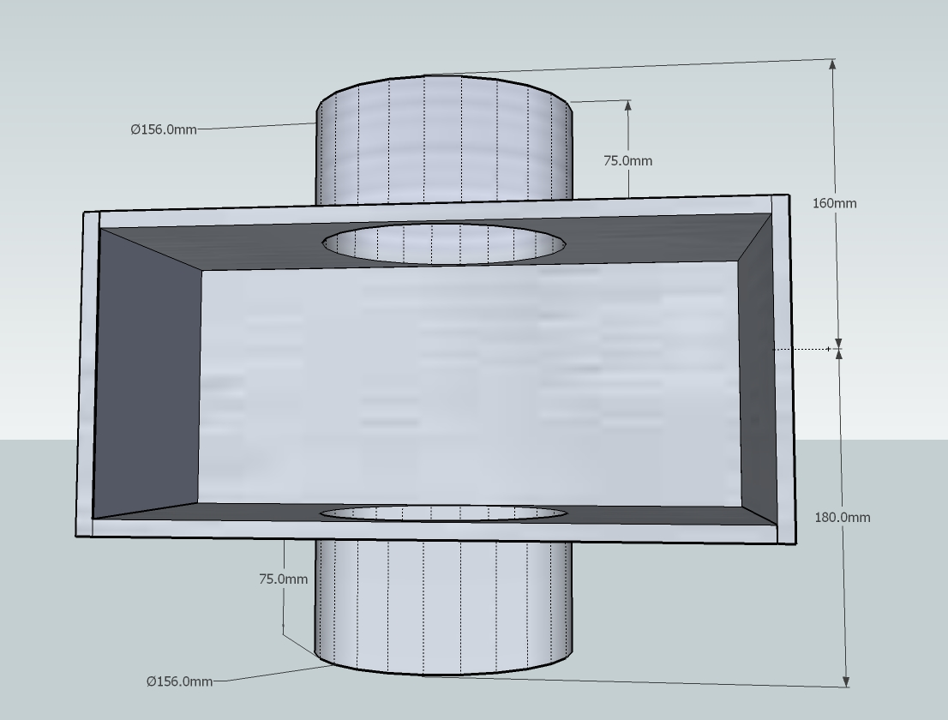
Vacuum Vessel
Vessel 3D (GTK 1+2) drawing .

Slide 5
GTK assembly carrier

Slide 6
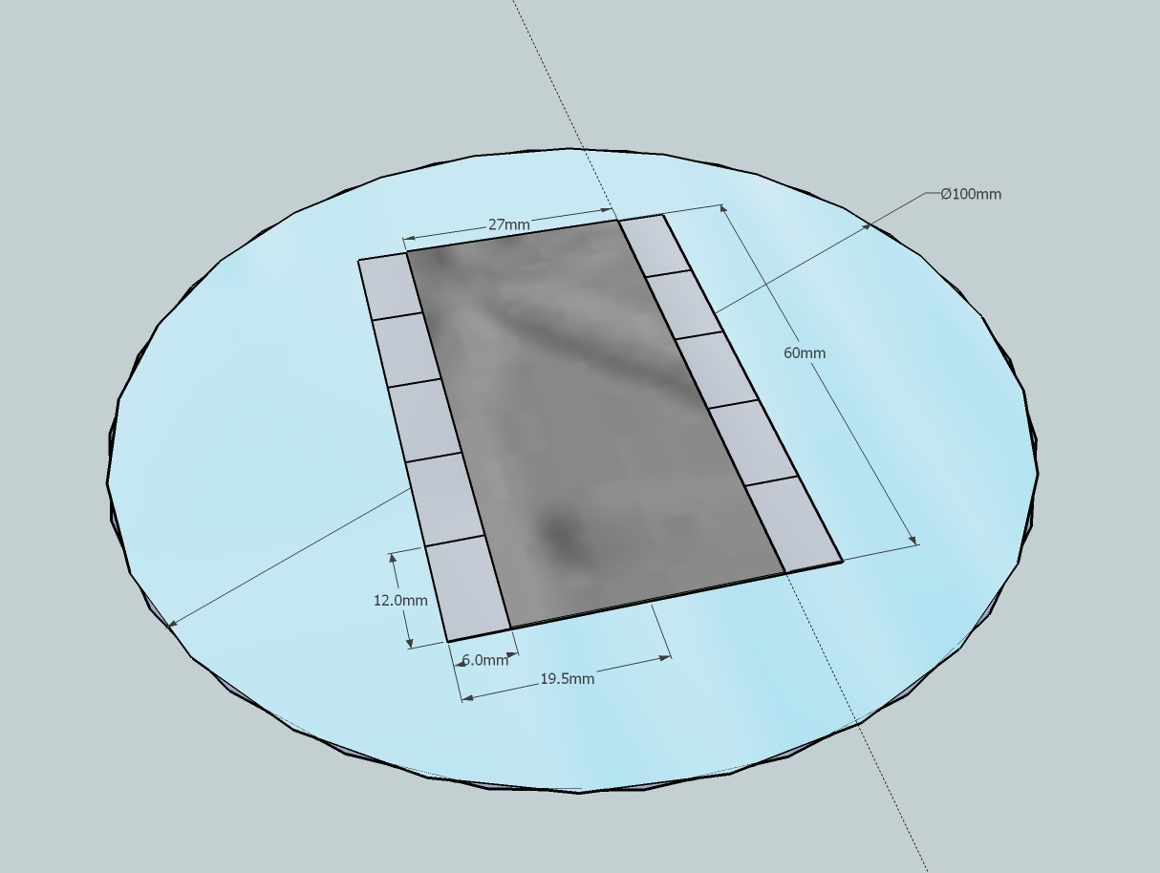
Integration of 10 Readout chips + Sensor with the Cooling Wafer
Reference #1
Sensor
First bond pad of 2 Readout chip could be used as references to precisely glue the sensor assembly on the cooling wafer.
Readout
chip
Cooling Wafer
Reference #2

Slide 7
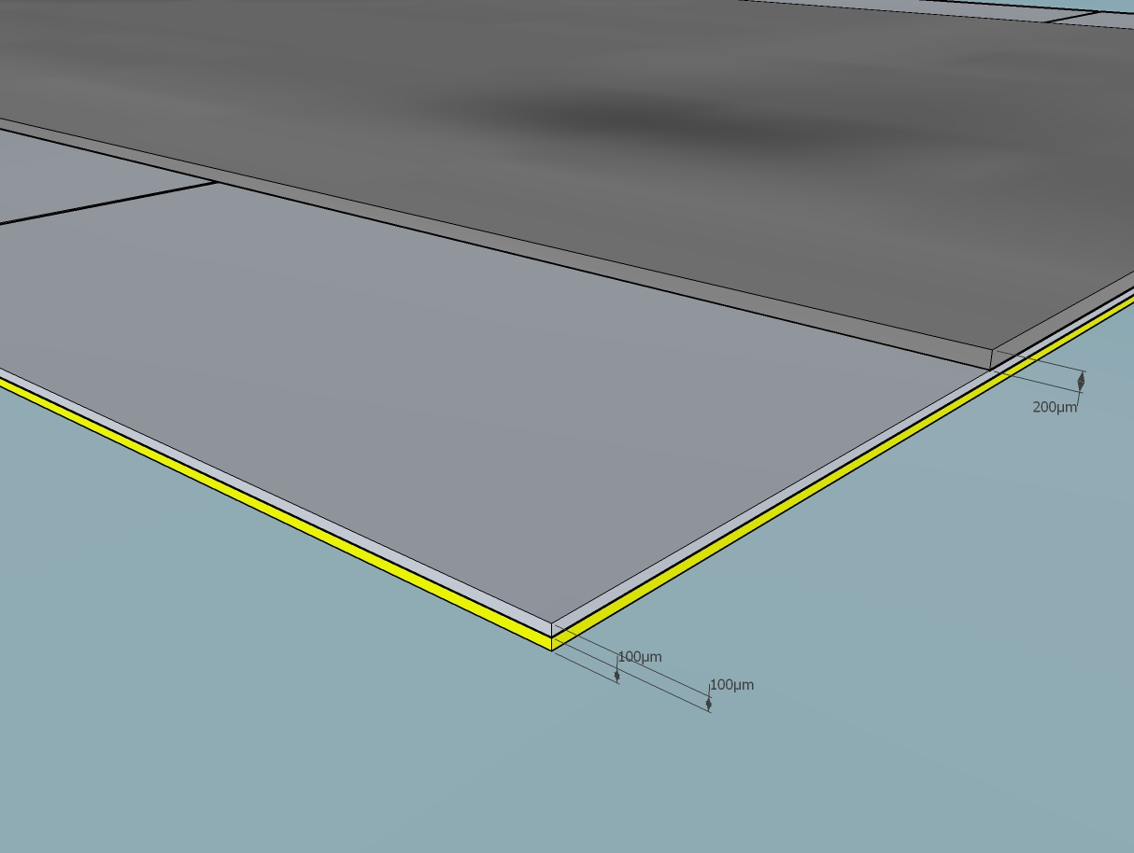
Gluing Readout chips on the cooling Wafer
Sensor
Special attention has to be taken to avoid an overflowing of glue to the readout chips pad and bump bonds.
Readout chip
Cooling Wafer

Slide 8
GTK assembly carrier
Top view
Bottom view

Slide 9
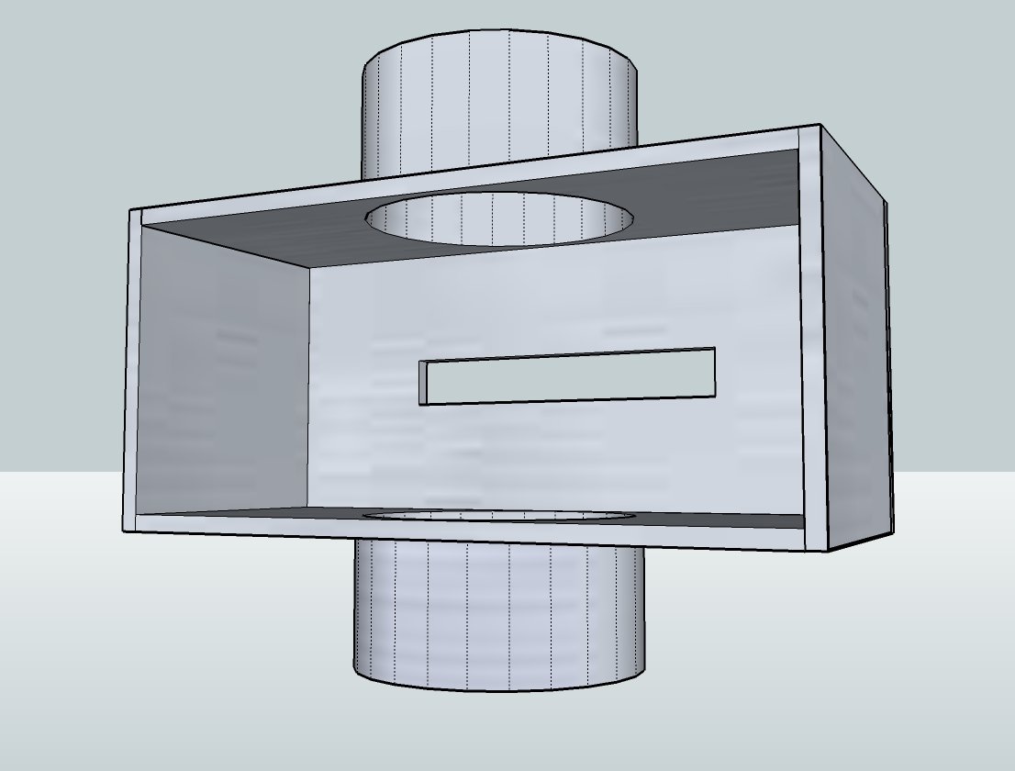

Slide 10
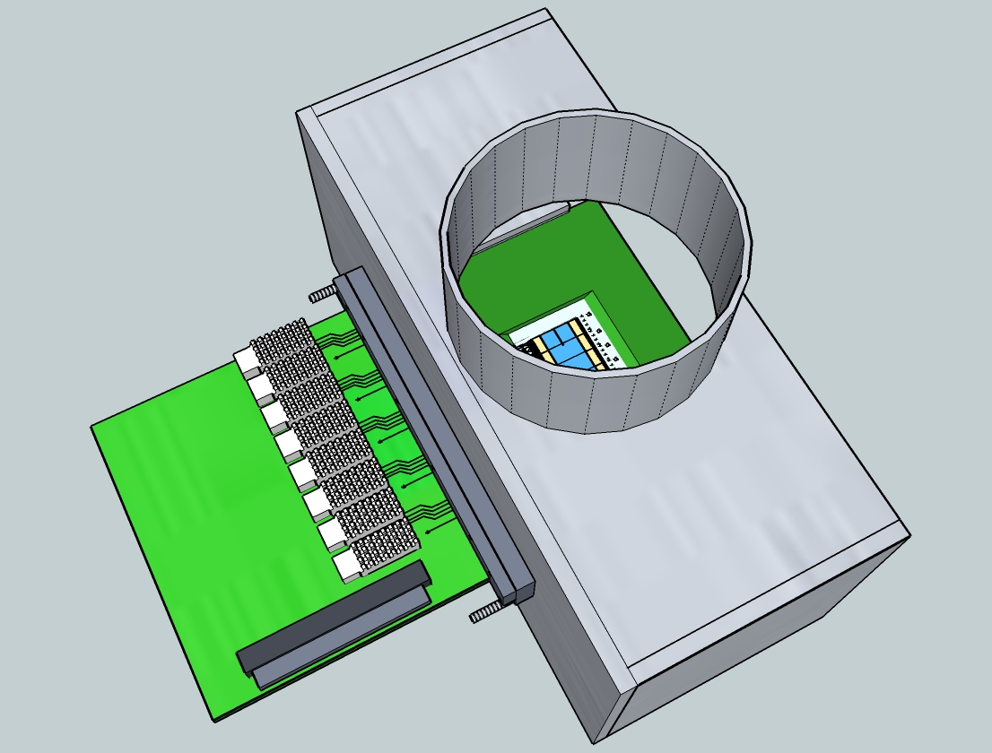
Vessel & Carrier board outside View

Slide 11
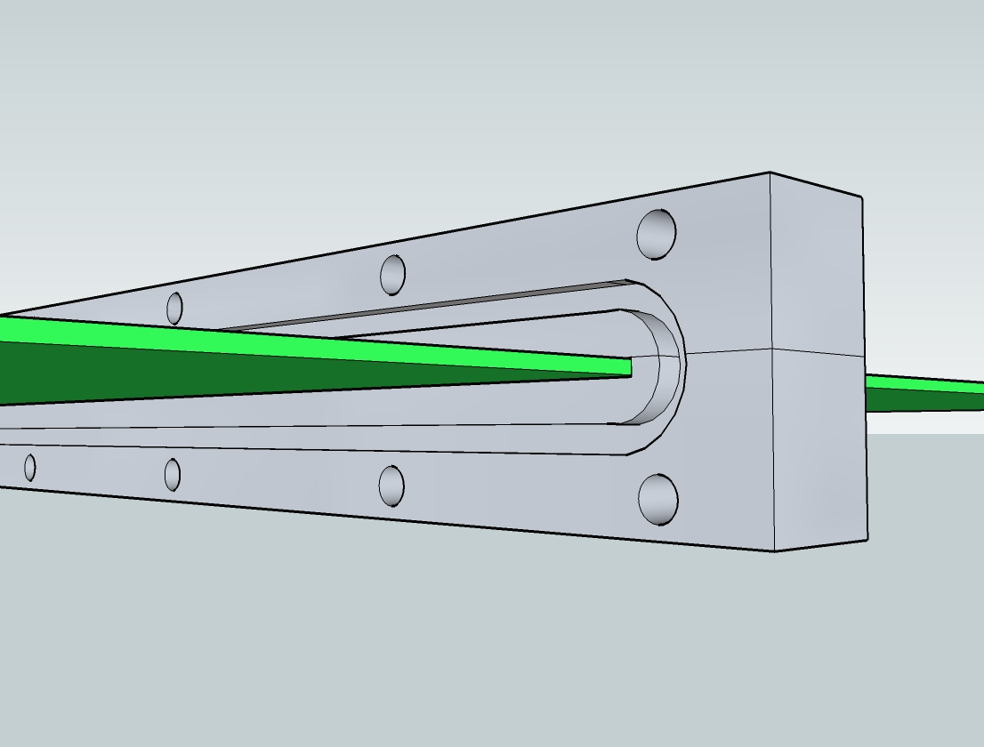
CARRIER BOARD SUPPORT
The aluminium support will be glued on the carrier board.
Vacuum tightness will be assure with an o-ring joint.
O-ring emplacement

Slide 12
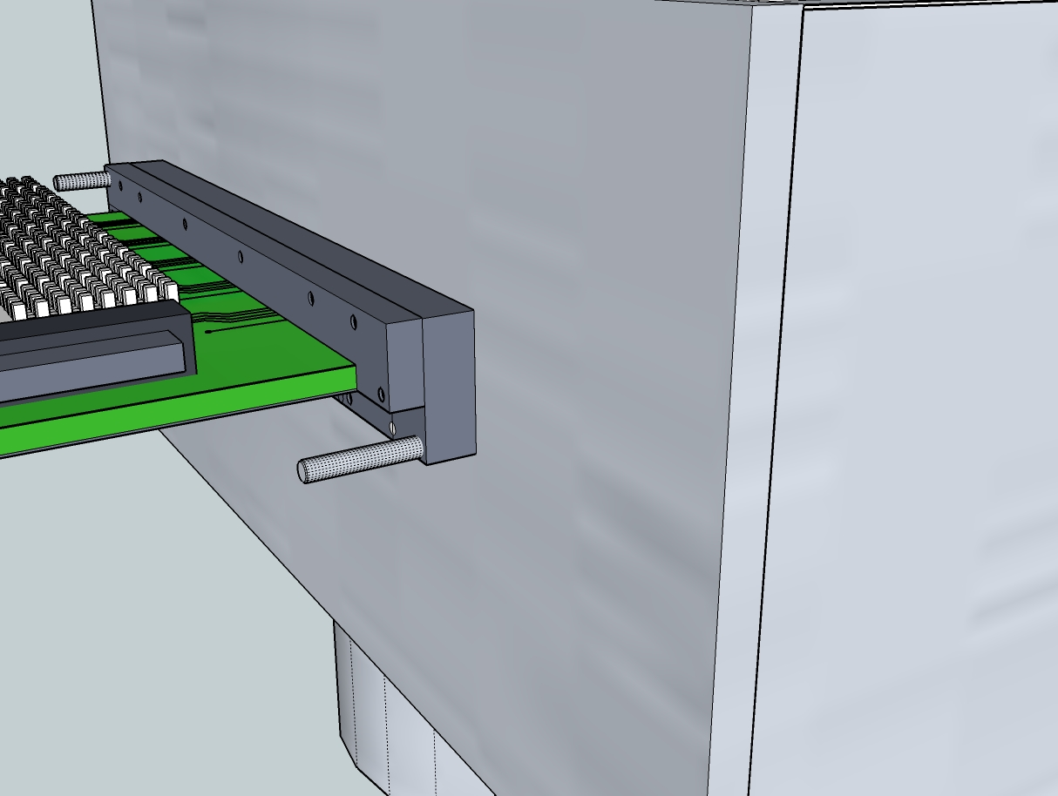
Mechanical guides used during
GTK carrier insertion in the Vessel.

Slide 13
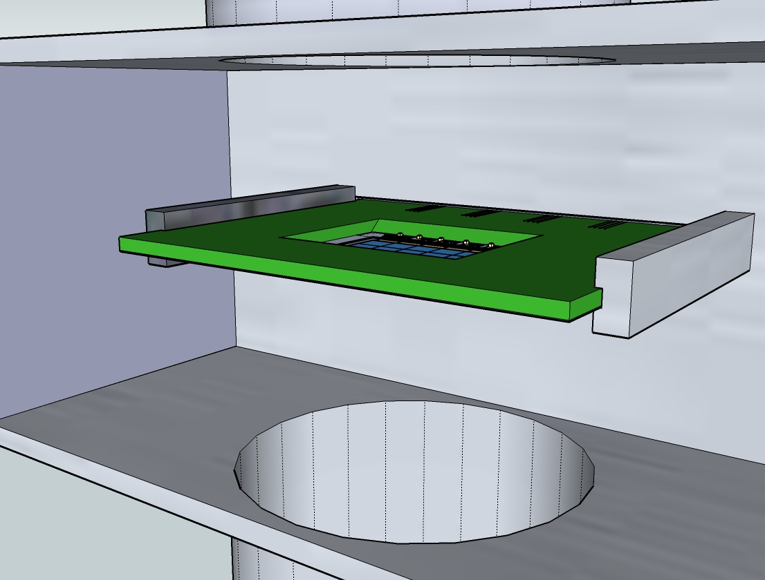
Mechanical guides
2 other rails will guide the GTK carrier inside the vessel.

Slide 14
Electrical connections to the GTK carrier

Slide 15
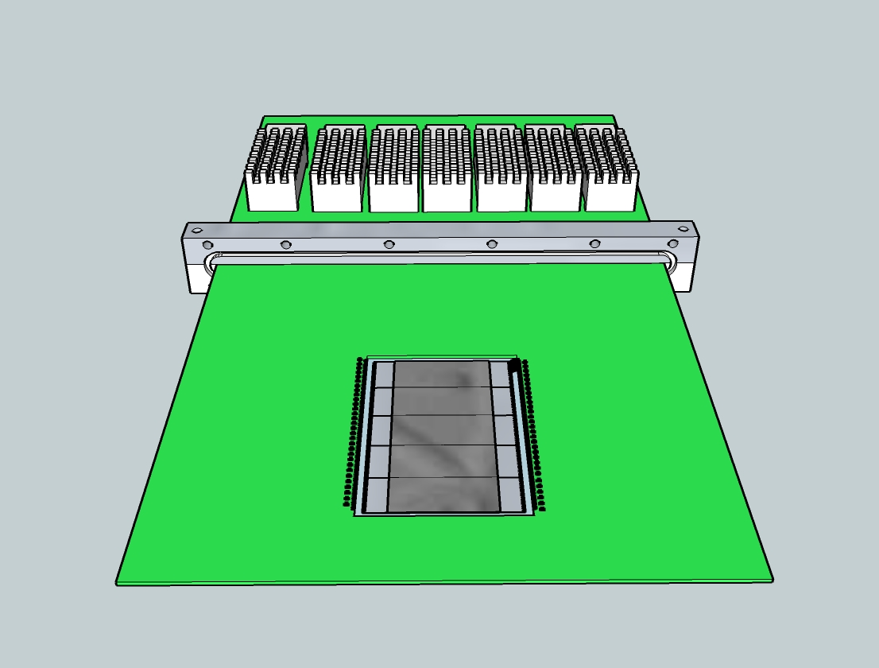
GTK carrier specifications
!! High frequency lines between The readout chips and optical transmitter modules.
µ via technology board is foreseen.
High current in the power supplies (25A)

Slide 16
Cross section representation

Slide 17
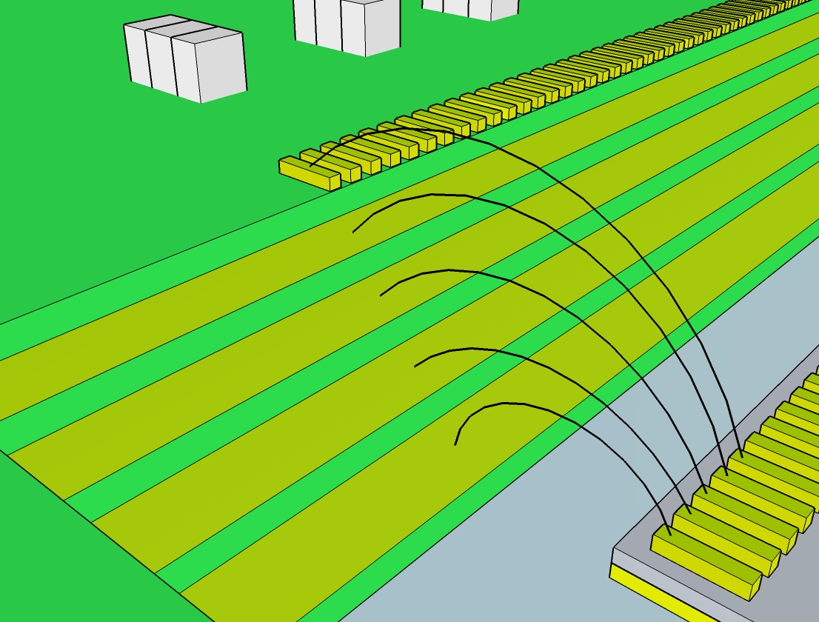
Bonding representation between GTK carrier and a Readout chip
Signals Layer
2V5A
2V5
1V2
Fist possibility:
This staircase carrier allows full planes for the power supplies.
GND

Slide 18
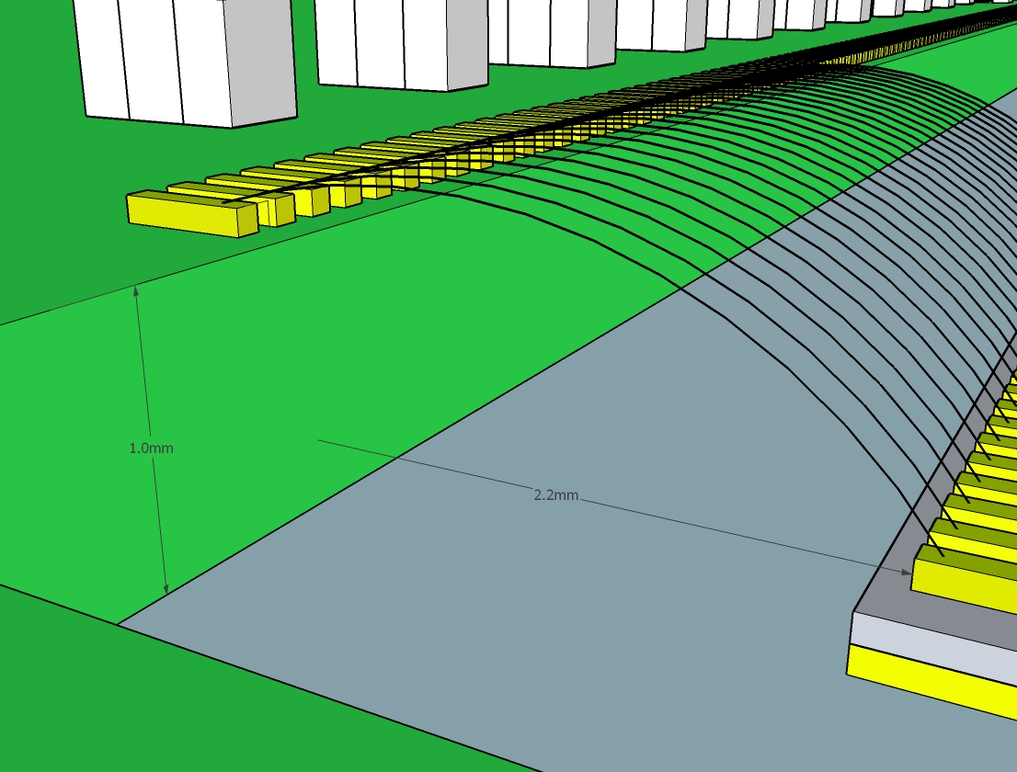
Bonding representation between GTK carrier and a Readout chip
Second possibility:
Pin to pin bonding

Slide 19
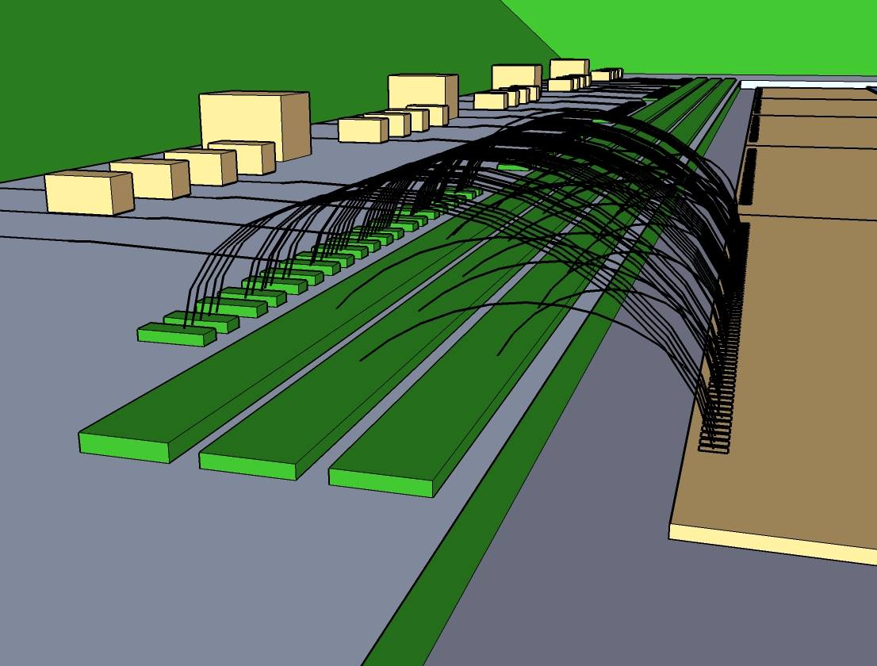
Bonding representation between GTK carrier and a Readout chip
Signals
2V5
1V2
GND
Third possibility:
Power supplies on bus

Slide 20
Cooling pipe integration

Slide 21
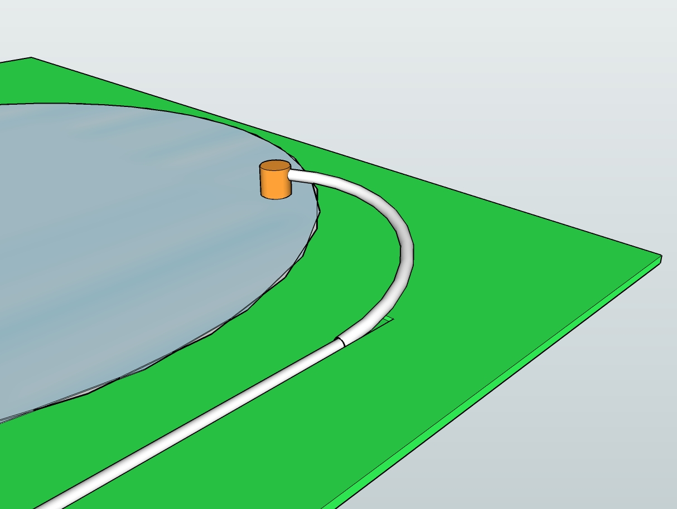
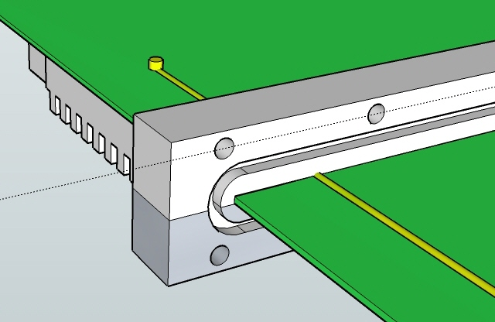
First possibility: Integration of the cooling pipe in the GTK carrier board
Nano port
Cooling pipe input
connector
Cooling Wafer

Slide 22
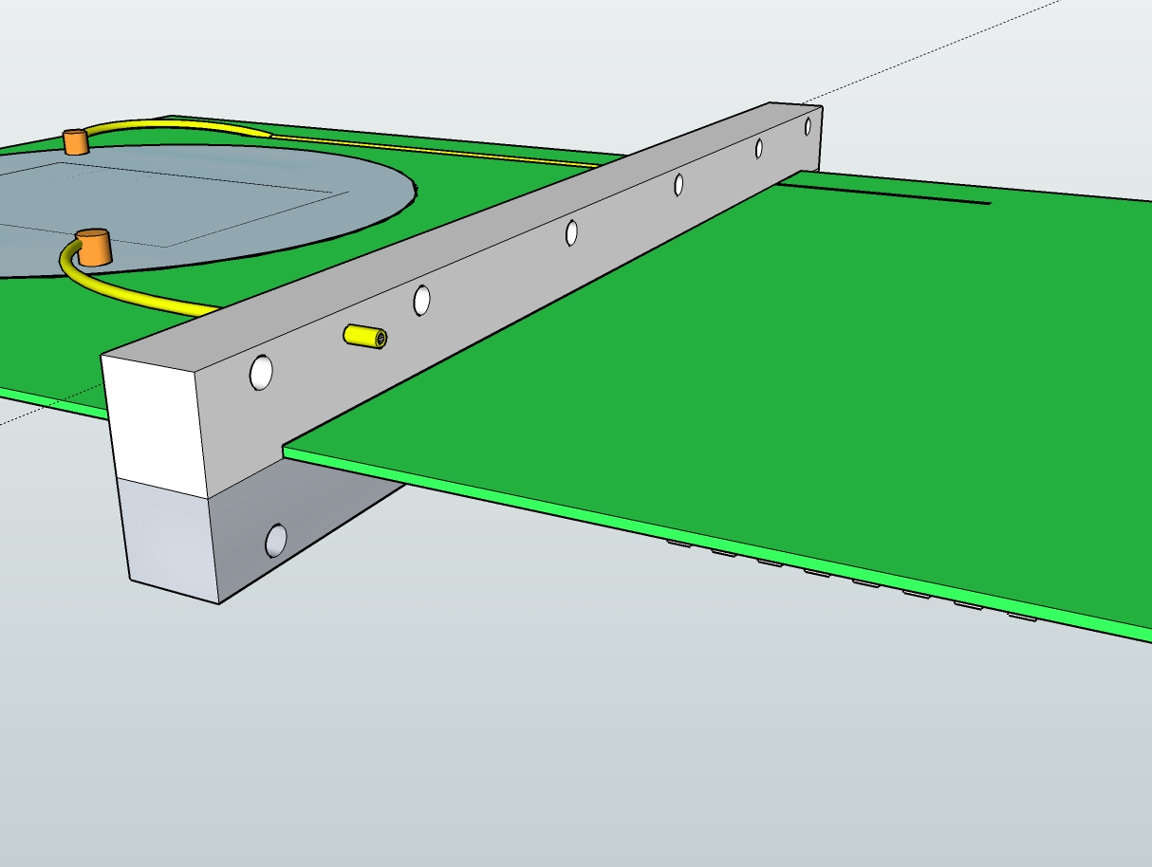
Second possibility: using the Aluminium support with a pressure-tight connector
Cooling pipe input connector

Slide 23
GTK Vessel & Beam Positioning

Slide 24
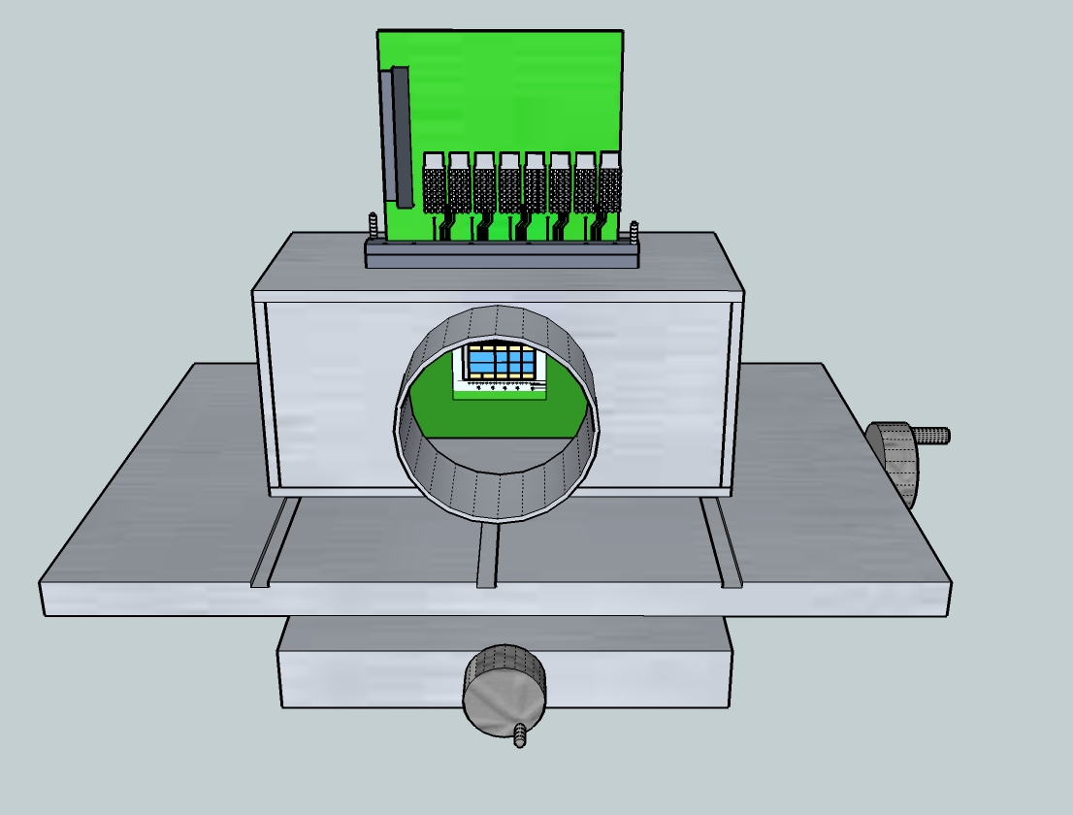
GTK Vessel and XZ table
Connections with the beam pipe could be made using a bellows (Tombac) to insure enough length and low stress.

Slide 25
Next steps
Design & construct vessel prototype
Study, design & construction of assembly carrier prototype
(PCB)
Mechanical dimensions
Signal integrity (6 Gbit/s per chip)
Signal length
Routing density
Wire bonding optimization
Straight wire bonds
Vacuum tightness
Start study to make design compatible with vessel cooling option

Slide 26
Conclusion
Definition of specification started
GTK3 needs more definition
Integration proposal worked out
Prototyping research & design can start

