Slide 1
GTK electro-mechanical integration NA62 GigaTracKer Working Group meeting Michel Morel

Slide 2
OUTLINE
Vessel dimensions
GTK assembly carrier
Electrical connections
Cooling pipes integration
Vessel alignment with the beam
Next steps
Conclusion

Slide 3
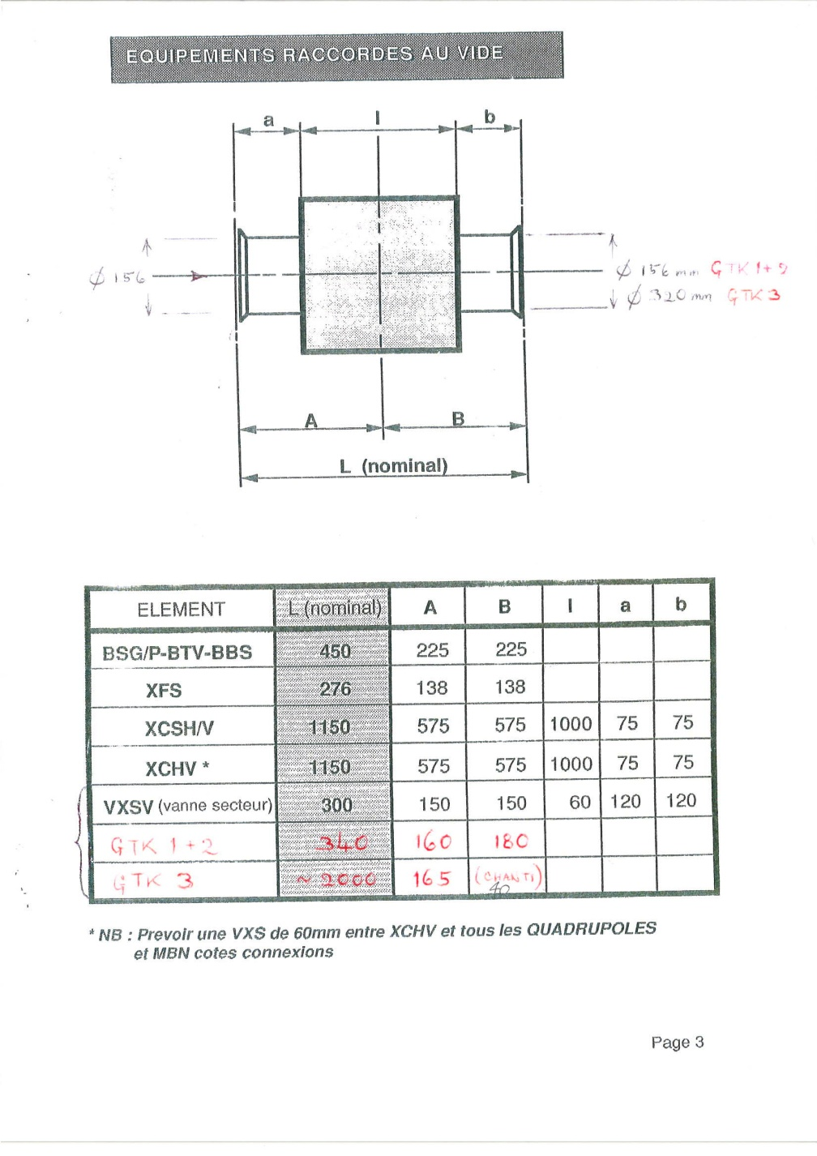
Vacuum Vessels

Slide 4
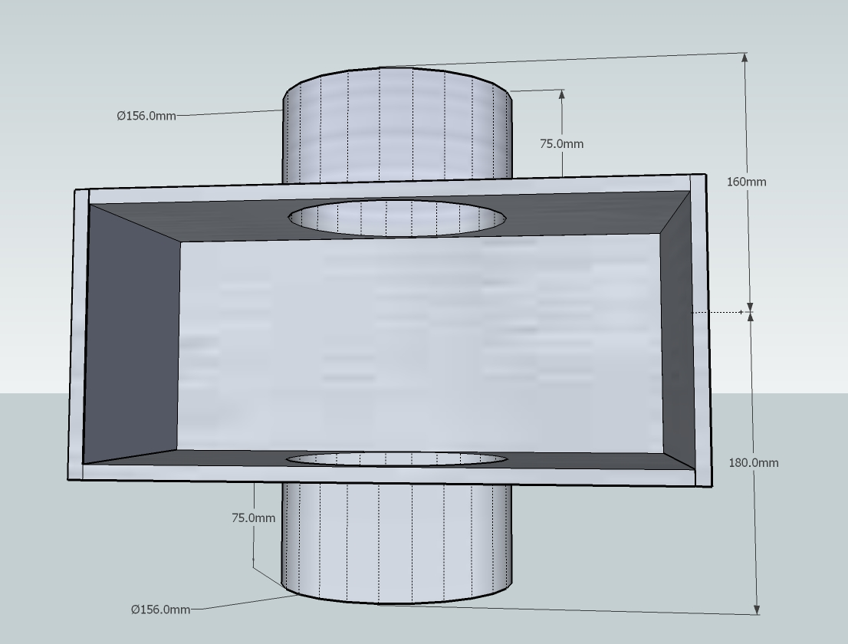
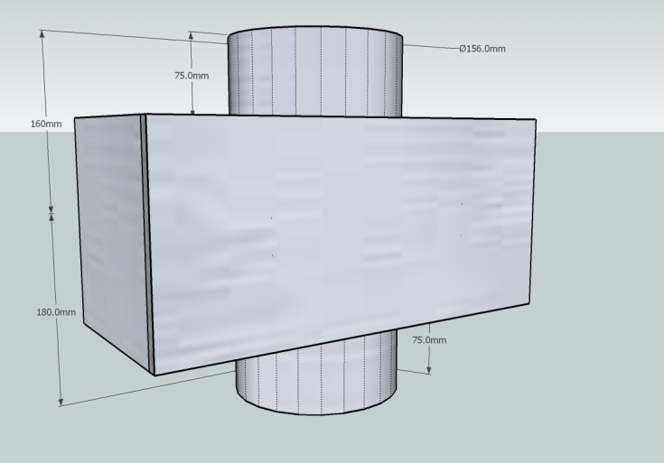
Vacuum Vessel
Vessel (GTK 1+2) drawings .

Slide 5
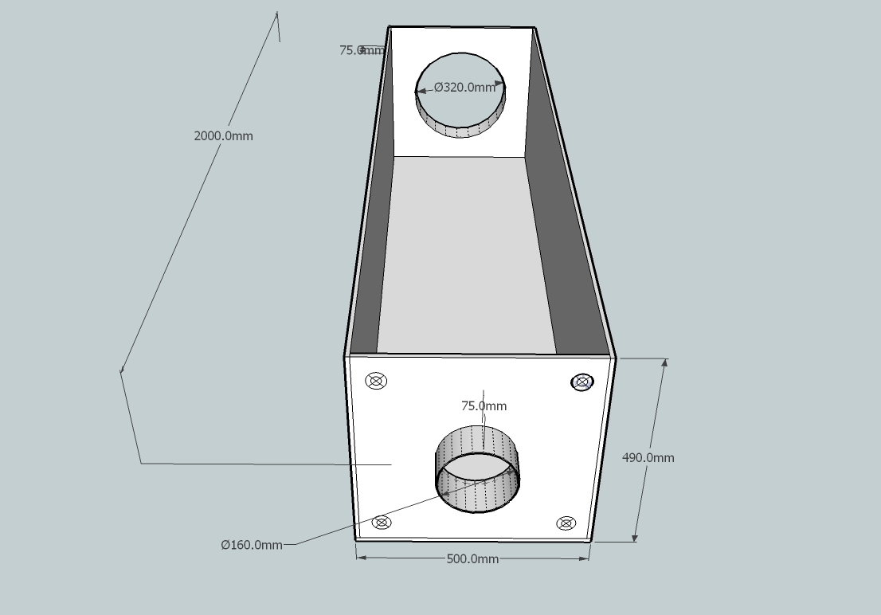
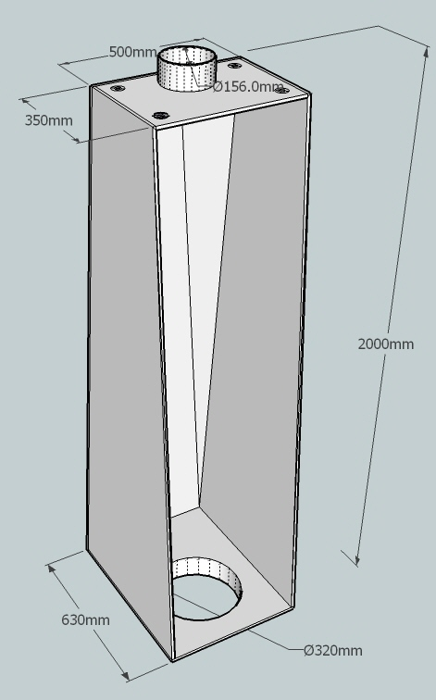
Vessel GTK 3 primarily drawings .

Slide 6
GTK assembly carrier

Slide 7
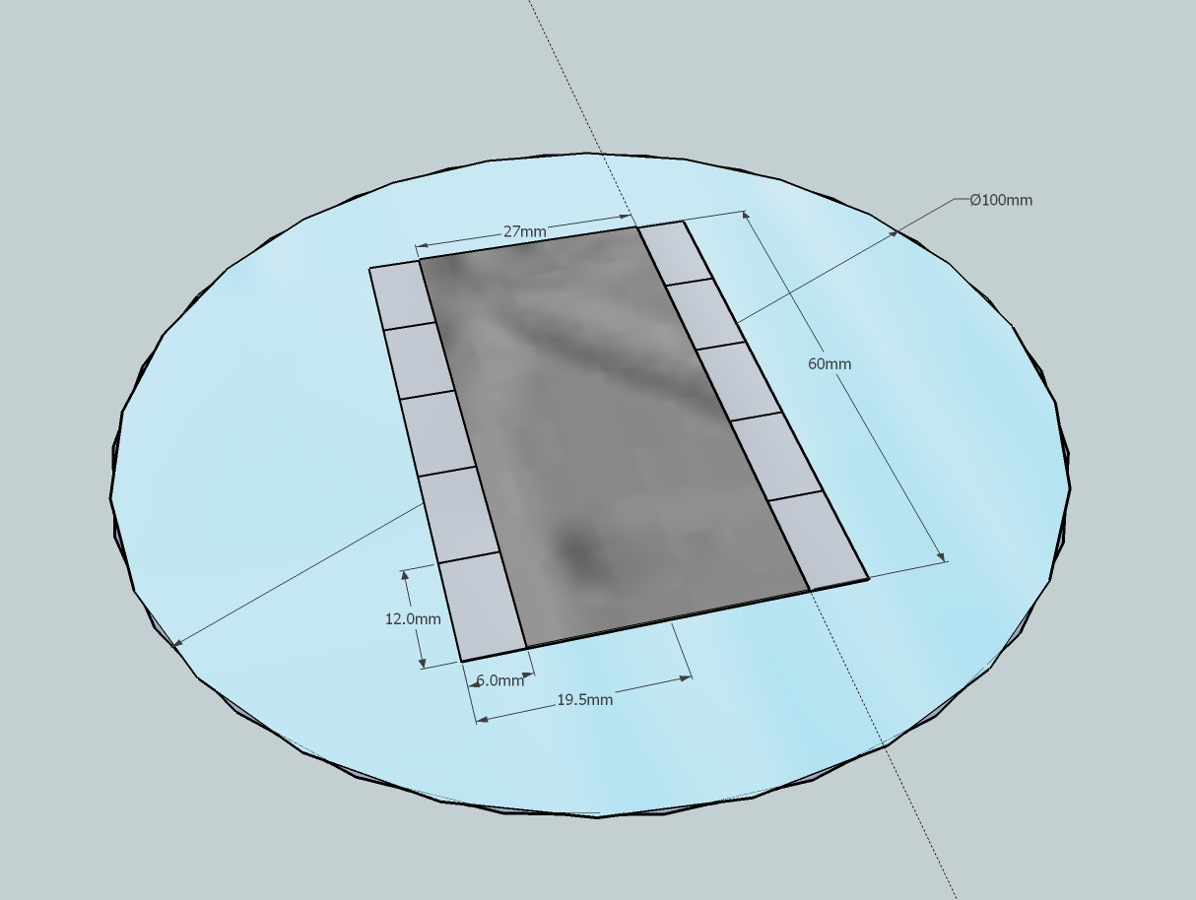
Integration of 10 Readout chips + Sensor with the Cooling Wafer
Reference #1
Sensor
First bond pad of 2 Readout chips could be used as references to precisely glue the sensor assembly on the cooling wafer plate.
Readout
chip
Cooling Wafer
Reference #2

Slide 8
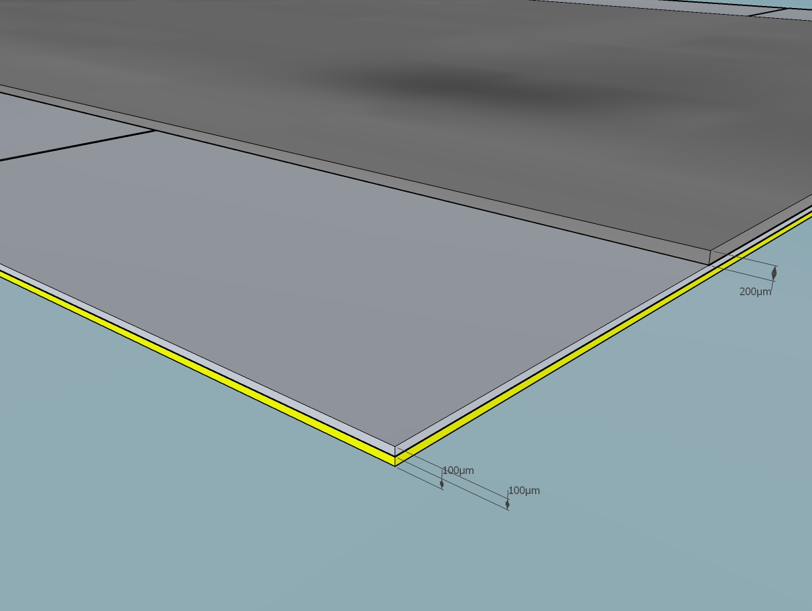
Gluing Readout chips on the cooling Wafer
Sensor
Special care must be taken to prevent an excess of glue spilling out and interfering with readout chip pads and bump bonds.
Readout chip
Cooling Wafer

Slide 9
GTK assembly carrier
Top view
Bottom view

Slide 10
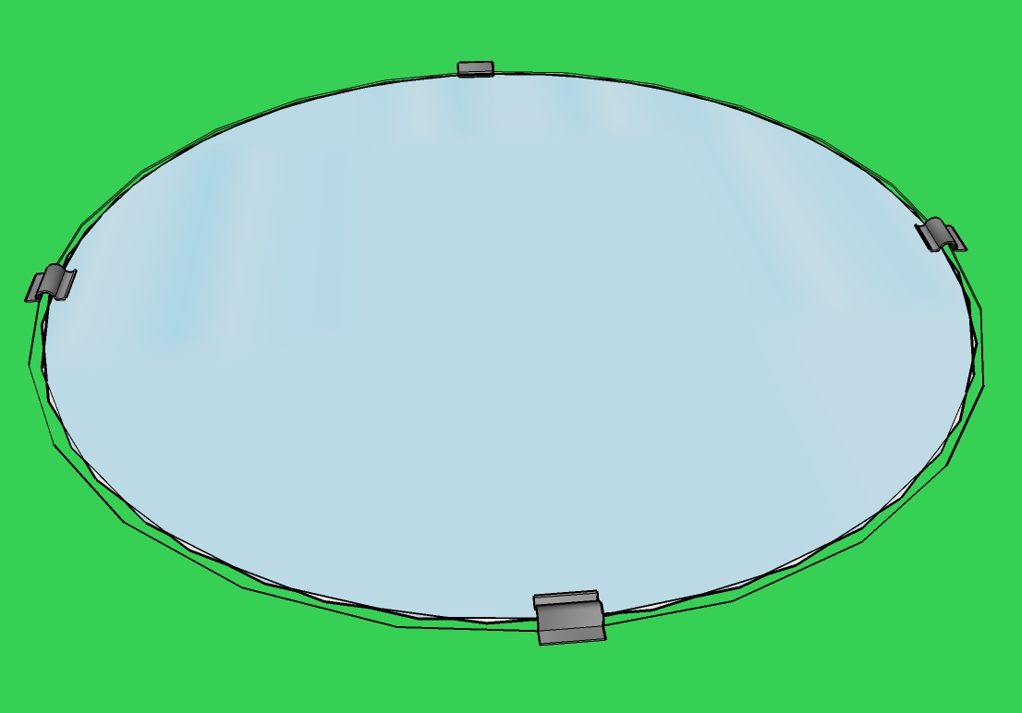
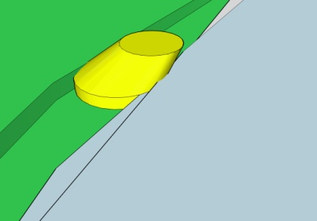
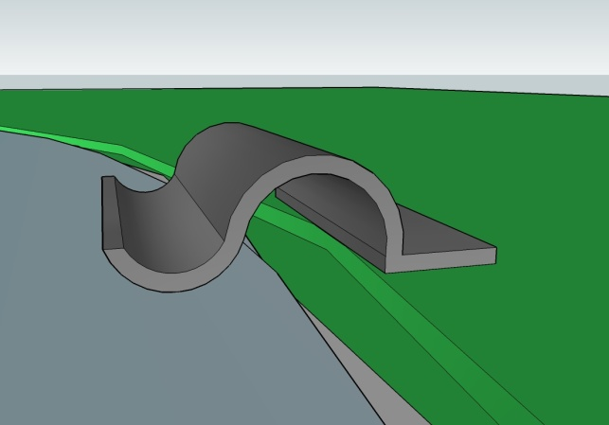
Temporary silicone glue spot
Cooling Wafer plate
Bottom side view
Carbon fiber clip
Other option consists to embed the cooling wafer plate in the Carrier Board by creating a depression in the PCB (200µm deep). Carbon fiber clips could keep the wafer plate in position, this option leaves the wafer free (few µm) and avoids the mechanical stress due to the different coefficients of thermal expansion between silicon and FR4.

Slide 11
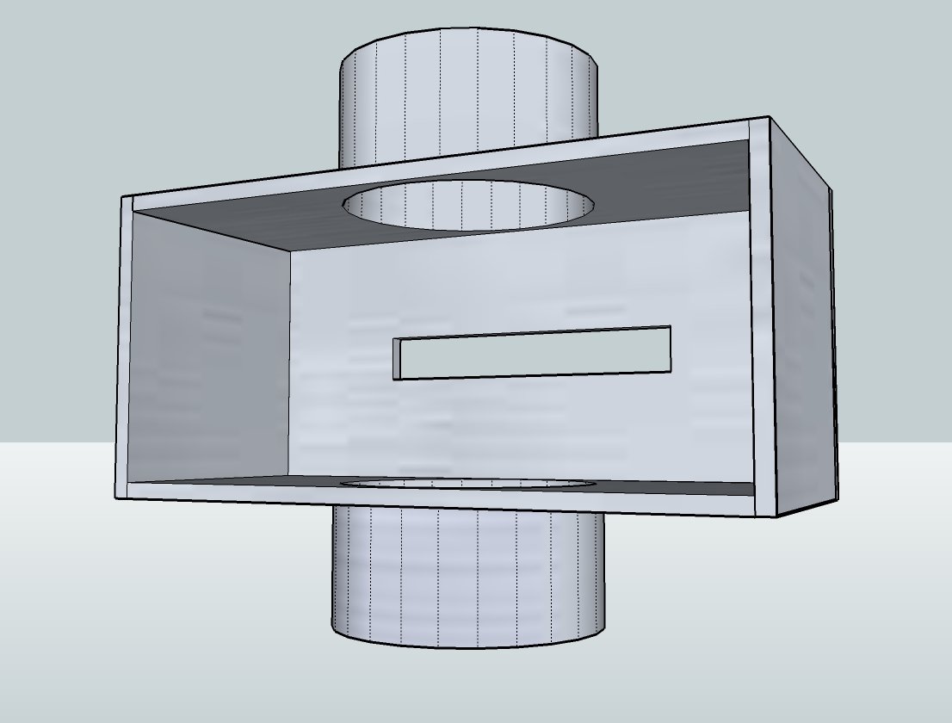
Vessel (GTK 1+2)

Slide 12
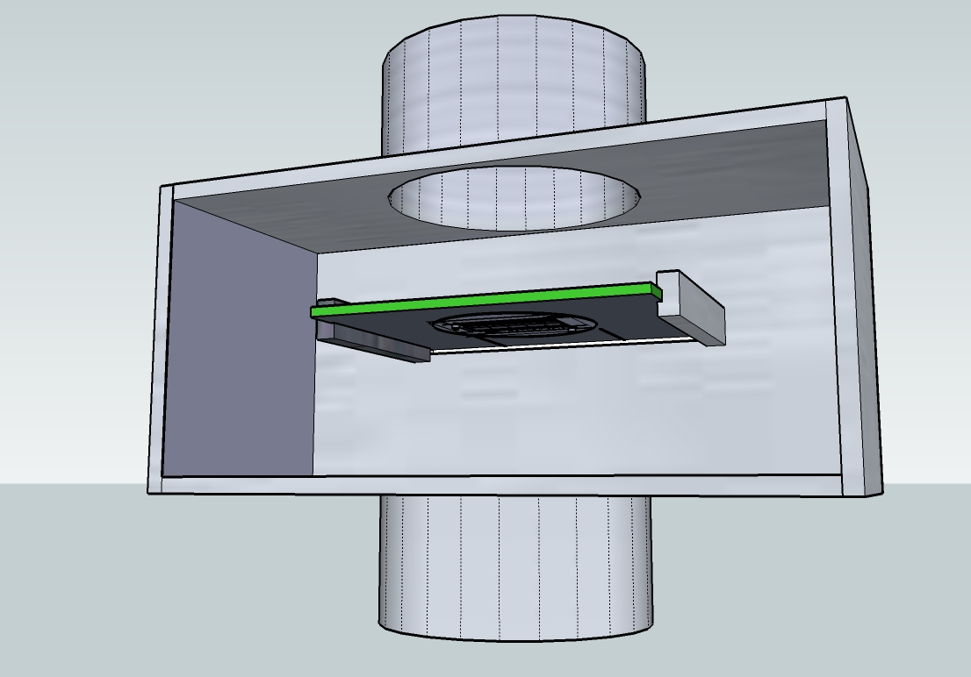
Vessel & Carrier board outside View

Slide 13
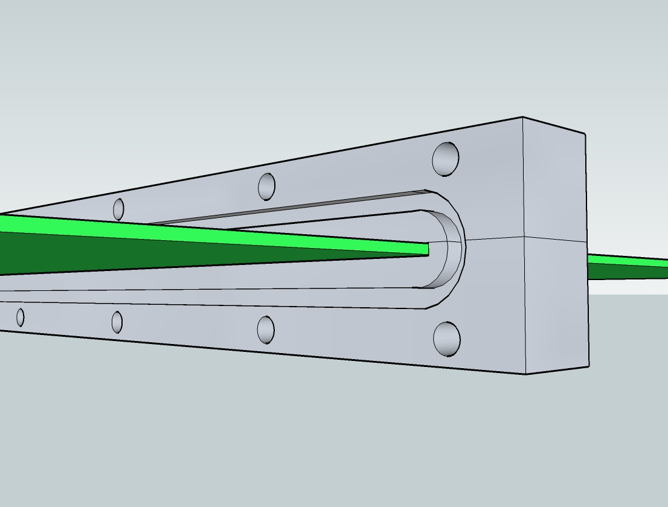
CARRIER BOARD SUPPORT
The Aluminium support will be glued on the carrier board.
Vacuum tightness will be assured with an o-ring joint.
O-ring emplacement

Slide 14
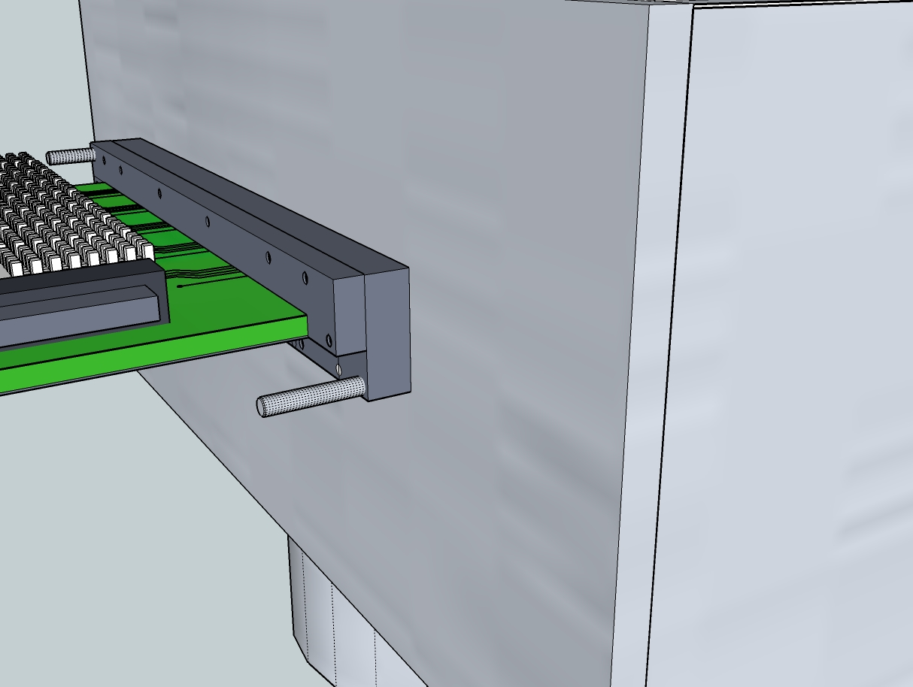
Mechanical guides used during
GTK carrier insertion in the Vessel.

Slide 15
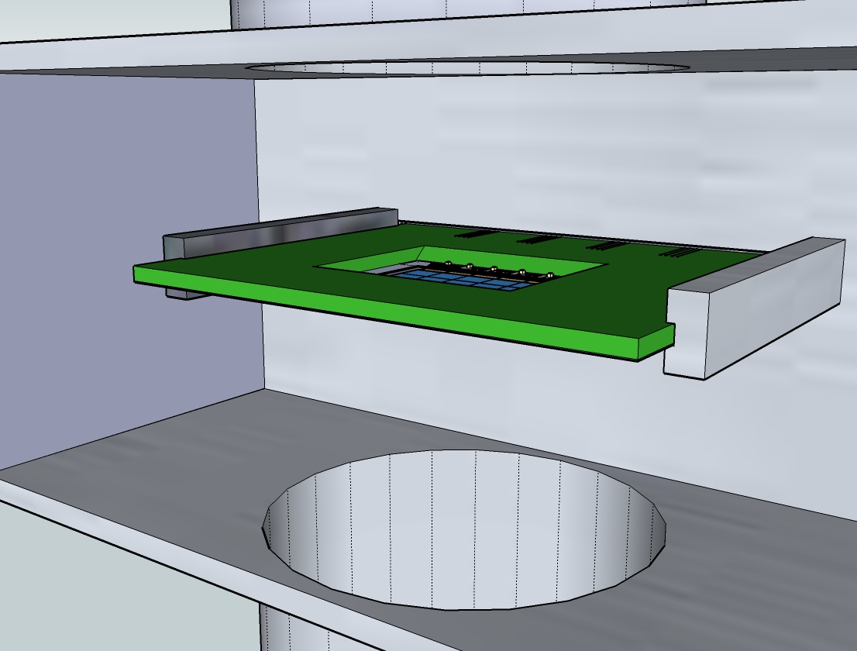
Mechanical guides
2 other FR4 rails will guide the GTK carrier inside the vessel.

Slide 16
Electrical connections to the GTK carrier

Slide 17
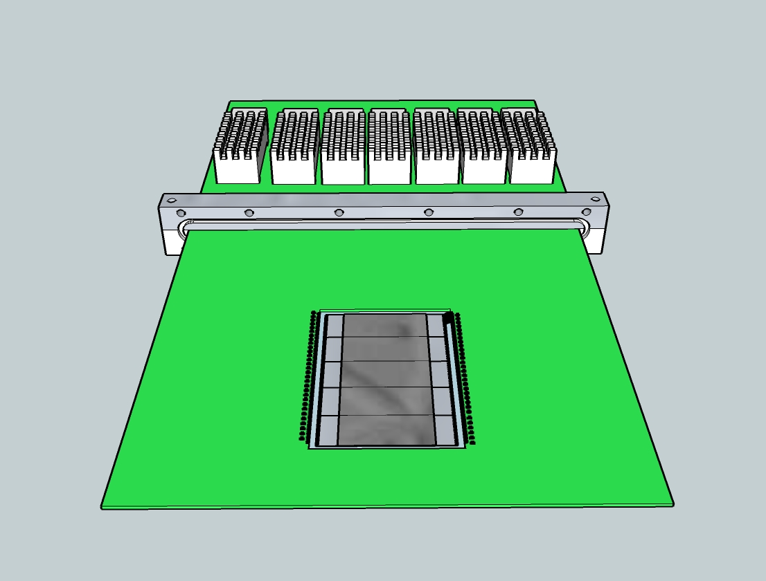
GTK carrier specifications
!! High speed serial links (3Gb/s) between the readout chips and optical transmitter modules
µ via technology board is foreseen.
High current in the power supplies (25A)

Slide 18
Cross section representation

Slide 19
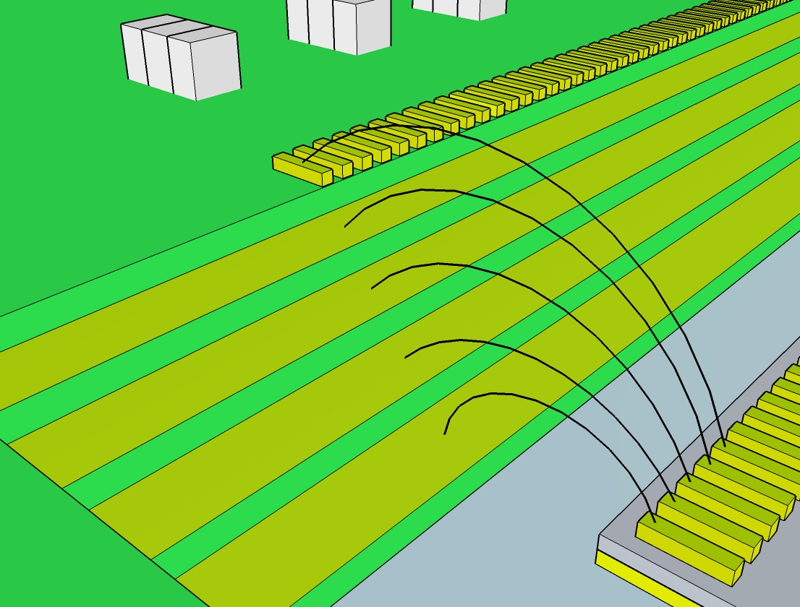
Bonding representation between GTK carrier and a Readout chip
Signals Layer
2V5A
2V5
1V2
First possibility:
This staircase carrier allows full power planes for the supplies and avoids creating “Swiss cheese” power planes
GND

Slide 20
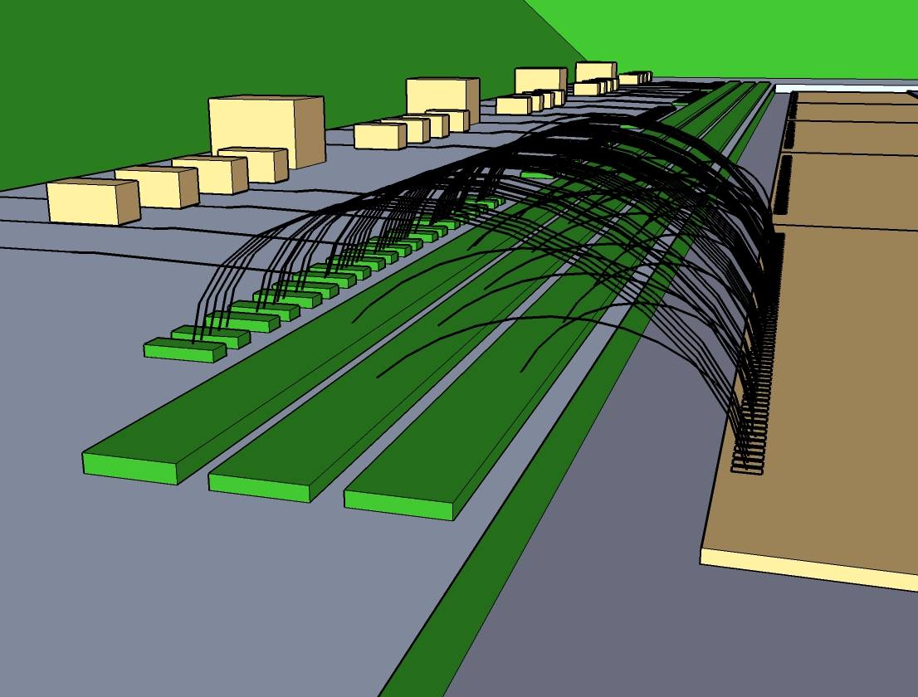
Bonding representation between GTK carrier and a Readout chip
Signals
Second possibility:
Power supplies on bus bars dedicated for each chip.
2V5
1V2
GND

Slide 21
Cooling pipe integration

Slide 22
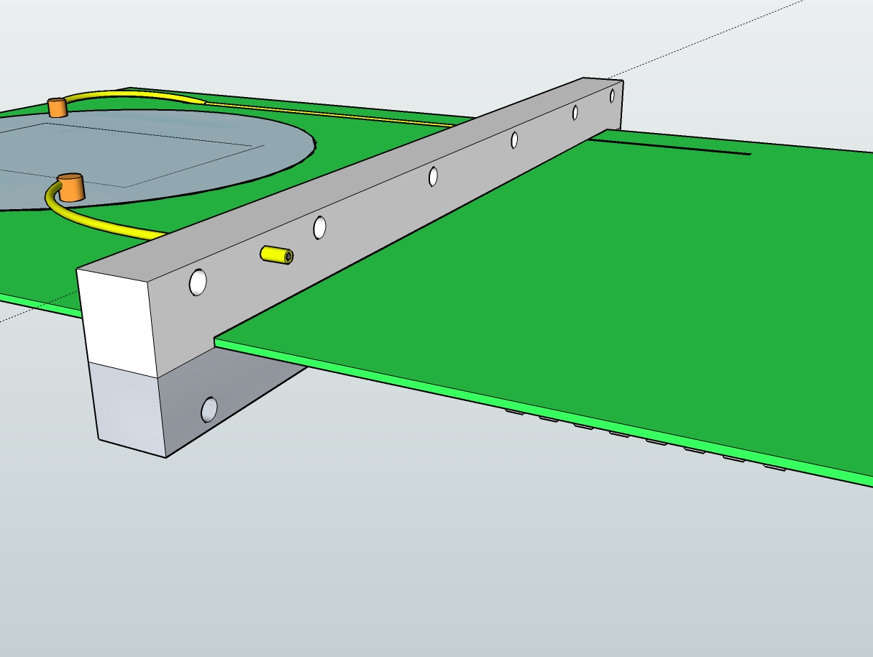
using the Aluminium support with a pressure-tight connector
Cooling pipe inlet should be isolated from the Aluminium support

Slide 23
GTK Vessel & Beam Positioning

Slide 24
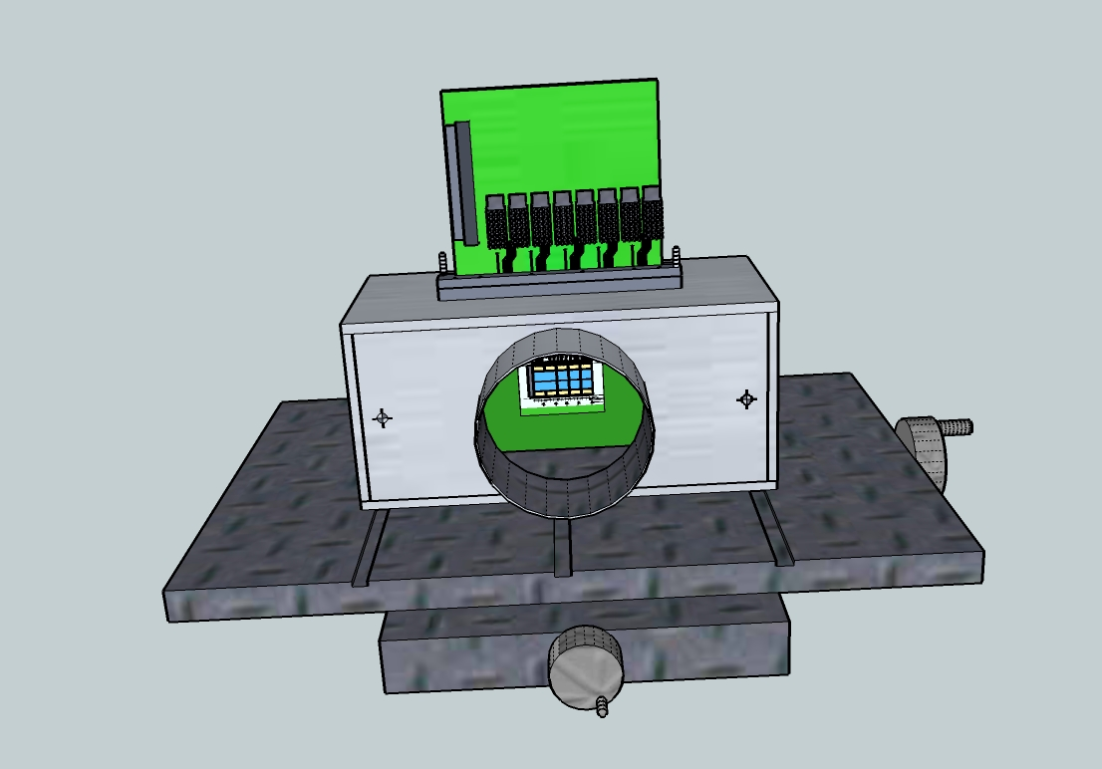
GTK Vessel and XY table
Connections with the beam pipe are made using bellows to ensure enough length and to relieve mechanical stress .

Slide 25
Next steps
Design & construct vessel prototype.
Define the chip interface.
Study, design & construction of assembly carrier prototype
(PCB)
Mechanical dimensions
Signal integrity (6 Gbit/s per chip)
Signal length
Routing density
Wire bonding optimization
Straight wire bonds
Vacuum tightness
Start study to make design compatible with vessel cooling option

Slide 26
Conclusion
Definition of specification started
GTK3 needs more definition (meeting at 2 PM today)
Integration proposal worked out
Prototyping research & design can start

